Slide 1
Perkins V
Texas Education Agency

Slide 2
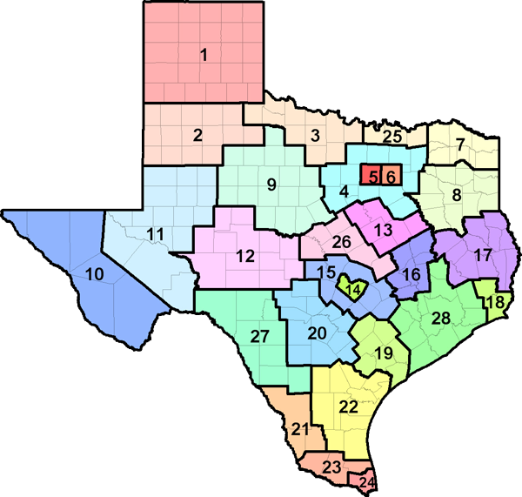
Texas CTE Background
Funding:
$110 million in Perkins Funds (secondary and postsecondary)
$2.2 billion in state weighted CTE funding (secondary)
Scale:
TEA is the fiscal agent for Perkins
Flow through funding for THECB
70/30 split secondary/postsecondary
954 districts receive Perkins Funds
80% of districts in state
Scope:
Perkins definitions set state definition for CTE quality
Alignment between federal and state monitoring and accountability

Slide 3
Timeline
Public Comment Period
Perkins V Draft Plan to SBOE for Discussion
Submit Perkins V Plan to SBOE for final approval
Submit Perkins V Plan to USDOE
Transition Plan Submission to USDOE
Drafting of Perkins V Four-Year Plan
March-August 2019
September -December 2019
January -February 2020
March 2019
April 2020
CTE State Baseline Performance Data
Revisions from Public Comment Period
Perkins V State Plan to Office of the Governor
Stakeholder Engagement & Feedback

Slide 4
Comprehensive Stakeholder Engagement
Listening tour and stakeholder engagement visits: p. 77-79
Over 145 individual meetings and district/region visits
Conferences and events: p. 80-82
TEA provided updates and information on Perkins V reaching over 6,500 stakeholders
Public comment: currently posted online through March where we will take feedback and incorporate prior to April SBOE meeting
Open public meetings: two scheduled over the next two months
Key Point
Texas’s Perkins V Plan is written by the Perkins V writing team. This team is comprised of TEA (including special populations), THECB, TWC, and TWIC. The goals align with 60x30 Texas and the Texas Workforce System Strategic Plan.

Slide 5
2020-2021 Regional Programs of Study
Regional Programs of Study | Approved ESC Regions
Cosmetology | ESC 1, 2, 3, 4, 5, 6, 7, 8, 10, 11, 12, 13, 17, 18, 19, & 20 *ESC Regions 9, 14, 15, & 16 did not apply
Maritime | ESC 4 & ESC 5
Aviation | ESC 4, ESC 10 & ESC 20
Drone (Unmanned Flight) | ESC 11 & ESC 19
Printing & Imaging | ESC 7 & ESC 13
Industrial Maintenance | ESC 7
Geospatial Engineering & Land Surveying | ESC 4
Retail Management | ESC 4 & ESC 20
Key Point
School districts within the ESC region are eligible to implement an approved regional program of study. Approved regional programs of study will be reevaluated every four years and the regional application process will occur annually.

Slide 6
Key Areas of Focus in Texas Plan
Align CTE programs with high wage, in-demand, and high skill occupations in Texas
Resources: programs of study, industry-based certification one-pagers, regional labor market information snapshots
Provide funding and opportunities for students to earn credentials (industry-based certifications, level I and level II certificates, associate, and bachelor degrees)
Resources: definition of quality CTE program, $ through Perkins Reserve Grants, $ through HB 3 for industry-based certifications, middle school, and summer CTE grants
Reduce the burden of CTE reporting structures at the district level
Resources: auto-coding and streamlined monitoring

Slide 7
Key Areas of Focus in Texas Plan
Provide opportunities for work-based learning in rural, small, mid-sized, suburban, and urban settings
Resources: Work-Based Learning Framework, employability skills rubric (pages 167-176 in state plan)
Construct, support, and promote meaningful and effective CTE cross sector collaboration in Texas across secondary, postsecondary, and the workforce
Resources: $ grants for CTE specialists at each ESC, Comprehensive Local Needs Assessment Guide, modeling through Tri-Agency and Perkins writing team
Ensure equitable access to postsecondary CTE programs and credentials through multiple on and off ramps for all students with a focus on special populations
Resources: Comprehensive Local Needs Assessment student data snapshots for each district

Slide 8
What is Required of Districts?
Needs Assessment
Local Application
Identify areas of strength in CTE systems/programs
Lay out eligible recipient’s vision or theory of action for CTE
Identify areas of weakness and gaps in CTE systems/programs
Identify strategies, solutions, and investments to sustain and scale strengths in CTE system/programs
Informed/validated by stakeholders and industry partners
Identify strategies, solutions, and investments to address weakness and gaps in CTE system/programs

Slide 9
Core Indicators of Performance
1S1: Four-Year Graduation Rate
1S2: Extended Graduation Rate
2S1: Academic Proficiency in Reading/Language Arts
2S2: Academic Proficiency in Mathematics
2S3: Academic Proficiency in Science
3S1: Postsecondary Placement
4S1: Non-traditional Program Enrollment
Program Quality
5S1: Attained recognized Postsecondary Credential
5S4: Program Quality: CTE Completer

Slide 10
Accountability vs. Perkins Performance
TEA Accountability
Measures college, career, and military readiness of all students
Career ready is defined by attainment of industry-based certifications
Perkins V
Measures quality of CTE programming
Quality is defined by CTE student performance on end of course exams, postsecondary placement, and credential attainment (of which industry-based certifications are one option)
Key Point
Previously TEA did not have data on CTE student program completion. Districts reported based on student intent and not established sequences of courses; making this measure unreliable across schools, districts, and state.

Slide 11
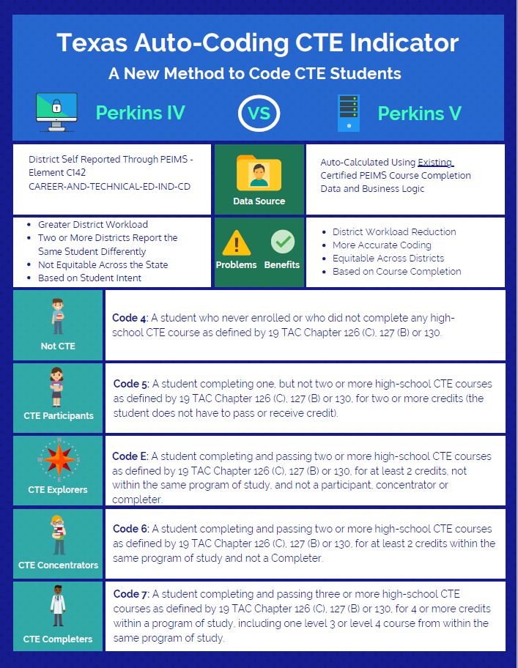
Who is included in the new CTE data?
CTE Indicators
Moving from district self-reported data through PEIMS to auto-calculate function using certified PEIMS course completion data
Using Perkins V definitions of CTE Concentrator & Completer
LEA and state baseline data

Slide 12
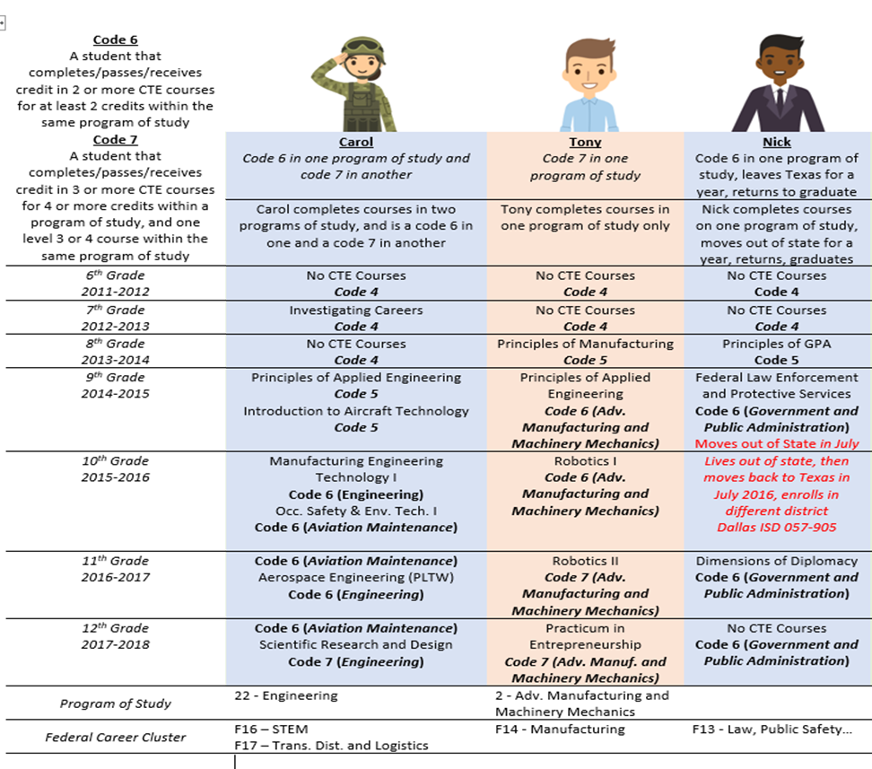
Perkins V Baseline Data
2017-2018 Graduation Cohort
Calculated based on course completion records from previous seven years
Uses Statewide Programs of Study
Regional Programs of Study will be added in future years.

