Slide 1
Educating The Children of Poverty by Focusing on Students and Families Presented by Dr. Esperanza Zendejas Superintendent
September 12, 2016

Slide 2
BISD Demographic Overview
Brownsville ISD is a Title 1 district with 47,300 students and 94.7% of the students identified as Economic Disadvantaged
32.5% of the students attending Brownsville ISD are identified as English Language Learners
65.2% of the students attending Brownsville ISD are identified as At Risk
Source: 2015 Texas Academic Performance Report

Slide 3
Areas of Focus to Support Student Achievement at BISD
1
Expand Opportunities for Student Achievement
2
Budget Focused on Student Achievement
3
Celebrate Student and School Achievements
4
Data Driven to Support Student Achievement

Slide 4
Expand Opportunities for Student Achievement
Coding Courses
All elementary students are receiving an introduction to coding. The goal is to expose them to the many job market opportunities.
Extended Day (5:30)
Key locations around the district are providing students a safe place to engage in extra curricular activities as well as providing them with academic assistance.
Master’s Program for Teachers
Current teachers have the opportunity to obtain a Master’s Degree in specific fields. In turn, this enables the district to provide additional dual enrollment courses.
1
Expansion of CTE Program
One Middle School will close its doors to become a school of opportunity for High School students. Students will be able to earn endorsements or licensures in different fields .
3 Year Old Program
BISD currently offers a 3 Year Old Program to Brownsville parents. This program aims to prepare children for school by enhancing their social and pre-reading skills.
Pre-Kinder
A newly revamped registration process provides more flexibility for parents of Early Childhood students.

Slide 5
Budget Focused on Student Achievement
Refocus Funding to Support the Lowest Performing Schools
Campuses with the lowest student achievement receive additional funding to develop innovative practices aimed at increasing student achievement.
Funding to Support Student Motivational Programs
Funds are allocated to maintain programs such as STEM, Fine Arts and Athletics to influence students to stay in school.
2

Slide 6
Celebrate Student and School Achievements
Scholarship Golf Tournament
An annual golf tournament is held to raise funds that will be awarded to Seniors to assist them with the cost of post-secondary education.
Dollars for Champs and Champions
BISD employees are given the opportunity to make a monetary donation towards scholarships. These funds are awarded to students and employees to assist with the cost of continuing their education.
Alumni Hall of Fame
BISD maintains partnerships with alumni and recognizes their successes. This encourages current BISD stakeholders to support college and career readiness initiatives.
Top Graduate Dinner
The top graduates and their parents, of each high school are invited to a dinner held in honor of their accomplishments.
Recognizing School Achievements
BISD continues to apply for grants, such as NCUST, aimed at recognizing high performing schools and awarding them with additional funding to implement innovative campus programs.
3

Slide 7
Data Driven to Support Student Achievement
Continuous Monitoring of School Leadership and Student Achievement
Based on Student Achievement Data, campus leadership is restructured to meet the needs of students.
Data Teams
The lowest performing schools identify a group of people to be their data teams. The teams are given the task to develop a plan to improve student achievement.
Refocus of Administrative Personnel
Based on data, district leaders are strategically assigned to the lowest performing campuses to provide support and mentorship.
4

Slide 8
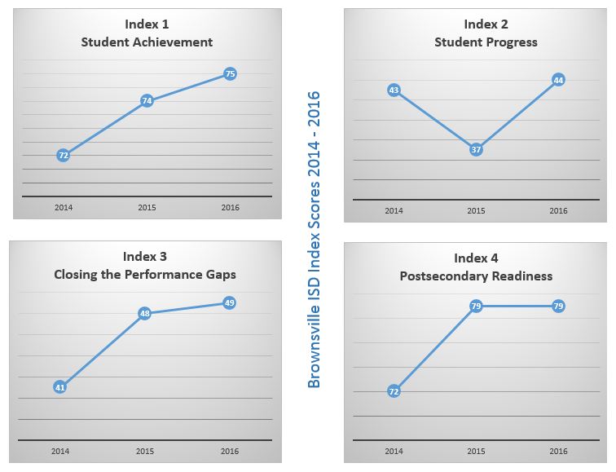

Slide 9
Questions ?

