Slide 1
Conference on Educating Children in Poverty Austin, Texas Monday September 12, 2016

Slide 2
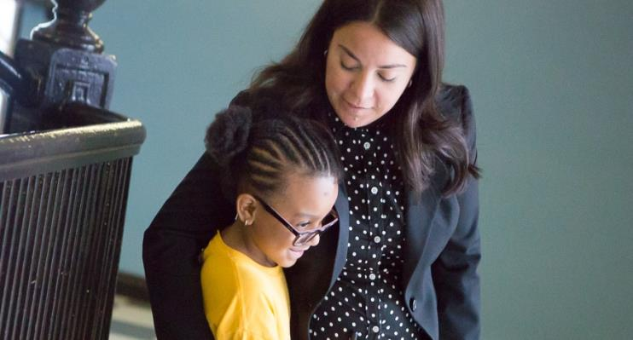
Too often, low-income students receive a second-rate education, leaving them unprepared for success in college and careers.
Low-income fourth graders are typically two-to-three grade levels behind.
Only half of low-income students graduate from high school.
Only 1 in 10 students who grow up in poverty earn a college degree by age 25.
“
Our children are dying. They don’t have a name, they don’t have a face. They are becoming just a statistic—‘children of color.’”
ISAMAR VARGAS NEW LEADER PRINCIPAL | CHICAGO, IL

Slide 3
All students deserve schools with a culture of achievement, where great teaching happens in every classroom, every day.
GREAT SCHOOL LEADERS MAKE THAT HAPPEN
14 months
of additional learning is achieved by students in schools with highly effective principals.
25%
of school impact on student learning is attributable to school leadership.
96%
of teachers say school leadership is critical in deciding whether they remain at a school.

Slide 4
Our programs equip leaders with all the skills they need to build thriving schools where students excel.
LEADERSHIP STANDARDS
INSTRUCTIONAL: Align curriculum, assessments, and instruction to rigorous academic standards
ADULT: Deliver trusted feedback and coach colleagues to excellence
CULTURE: Foster high expectations and shared accountability
OPERATIONAL: Align resources to support instructional priorities
PERSONAL: Reflect and improve practice
Instructional
Adult
Culture
Operational
Personal

Slide 5
We develop great education leaders at every level – from teacher leaders to superintendents.
LEADING INSTRUCTION
TRANSFORMING TEAMS
EMERGING LEADERS
PRINCIPAL INSTITUTE
PRINCIPAL SUPERVISORS
ASPIRING PRINCIPALS
LEADING INSTRUCTION: Equips current and aspiring leaders with instructional leadership expertise aligned to high academic standards
EMERGING LEADERS: Teacher leaders and assistant principals master key leadership skills while supervising a teacher team
ASPIRING PRINCIPALS: Prepares tomorrow’s principals to achieve breakthrough results with a yearlong residency and induction support
TRANSFORMING TEAMS: Provides a structured framework for collaboration as instructional teams work together to advance student achievement
PRINCIPAL INSTITUTE: Bolsters leadership skills of current principals and assistant principals using our proven curriculum and training model
PRINCIPAL SUPERVISORS: Prepares principal supervisors to cultivate instructional excellence across a school system

Slide 6
We have built a movement of diverse leaders, preparing them with the skills to transform schools and students’ lives.
88% of the students we serve are children of color
64% of New Leaders’ alumni are people of color
56% of New Leaders’ staff are people of color

Slide 7
Since 2000, we have trained nearly 2,500 school leaders who now reach 450,000 students every year.
Minneapolis
Rhode Island
Chicago
Bridgeport
Bay Area
Norwalk
Central Valley
New York City
Fresno
Jersey City
Newark
Pasadena
Los Angeles
Arlington
Baltimore
San Antonio
Memphis
Washington, DC
Hidalgo County
Dallas
Duval County
WE WORK IN OVER 20 HIGH-NEED CITIES AND 100 CHARTER SCHOOLS
83%
of students served are low-income
88%
of students served are children of color

Slide 8
Our partnership with Arlington is powered by a perfect alignment between the district’s priorities and New Leaders’ expertise.
ARLINGTON, TEXAS
YEAR LAUNCHED: 2014
LEADERS TRAINED: 60
STUDENTS REACHED: 3,800 per year
PROGRAM:
Emerging Leaders
Notes:
Our partnership with Arlington is powered by a perfect alignment between the district’s priorities and New Leaders’ expertise.
We launched our Emerging Leaders program in 2014. We have since trained 60 leaders who reach about 3800 students in Arlington annually.

Slide 9
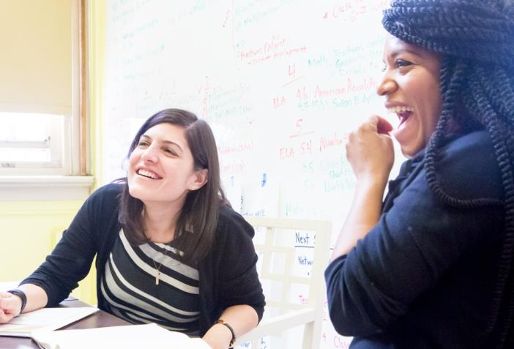
In 2012, the Arlington Independent School District launched a strategic plan to ensure all schools prepared students for college and careers.
70% of Arlington students are low-income
69% of Arlington students are black or Hispanic
26% of Arlington students are English-language learners
To achieve this ambitious vision, the district needed a pipeline of great leaders with the skills to address the diverse needs’ of Arlington students

Slide 10
Arlington officials planned to operate a district-run Aspiring Principals Academy, but they quickly encountered bandwidth challenges.
CONDITIONS FOR SUCCESS | CHALLENGES
A selection model that identifies candidates with leadership potential | Struggle to build robust pool; need to develop objective selection criteria
A curriculum that helps participants master key leadership skills | Curriculum development to promote instructional leadership
Job-embedded coaching so participants can apply what they learn | Lack of bandwidth and point person to implement program
A robust system to measure program outcomes | Evaluation design to accurately measure outcomes, including impact on learning

Slide 11
Emerging Leaders ignited a culture shift across the district, with leadership roles earned based on skills rather than seniority.
91% of participants successfully completed the program
53% of completers were promoted directly into principal or AP roles

Slide 12
Emerging Leaders participants led impressive learning gains in their schools, even while still completing training.
100% of participants working with math teams led gains across those classrooms, with 75 percent achieving double-digit gains
72% of Emerging Leaders led proficiency gains across the classrooms they influenced
69% of Emerging Leaders oversaw student gains of at least five percentage points against their SMART goals

Slide 13
SELENA OZUNA | PRINCIPAL | ARLINGTON, TX
As a new principal at Bud Remynse Elementary, Selena Ozuna wanted her students – half of whom are English learners – to make meaningful gains in all subjects.
With her coach, Ozuna fostered a culture of high expectations and taught teachers to analyze data and target instruction to better meet student needs.
Ozuna credits Emerging Leaders with equipping her to build the trust to lead teachers and students to success.
Emerging Leaders gave me tools to raise the bar and taught me to foster strong relationships, so I could have difficult conversations without teachers putting up a wall.”
Third-grade math proficiency at start and end of training

Slide 14
RAY BORDEN | PRINCIPAL | ARLINGTON, TX
With two years as an assistant principal, Ray Borden thought he had a head start in Emerging Leaders, but by December, achievement had plateaued.
Borden’s coach helped him see he was relying on charisma rather than strategy, guiding Borden to remedy distrust by using program tools to structure difficult conversations.
By year’s end, 94% of first-time test takers passed the state biology exam, and district officials tapped Borden to become a principal.
I realized that I was too focused on me driving the bus. If we were really going to move achievement, the team would need to do that, together.”
First-time test takers passing state biology exam
PRIOR YEAR
SMART GOAL
OUTCOME

Slide 15
CONTACT US www.NewLeaders.org (646) 792-1070

