Slide 1
Turning High Poverty Schools into High Performing Schools
TNTP’s Approach
September 2016

Slide 2
TNTP was founded in 1997 by teachers who believed all students—particularly poor and minority students—deserved great teaching.
Research shows that students with even one top teacher….
are less likely
to have children
as teenagers…
are more
likely to attend
college…
earn a
higher salary…
and save more
for retirement.
2
Notes:
Analysis of 20 years of data on 2.5 million students in grades 3-8, including 18 million tests, and tax records on parent characteristics and adult outcomes. Source: Chetty et al., 2011.

Slide 3
Our 400-person staff works with school districts, charter networks, and state departments of education with a mission of ending educational inequity.
TNTP School District and State Partners, 1997 to Present
State Departments of Education School Districts & Charter Management Orgs
TNTP has worked in 33 states and 23 of the 25 largest U.S. cities.

Slide 4
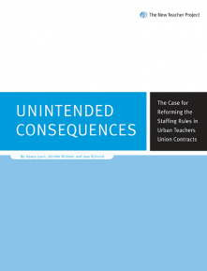
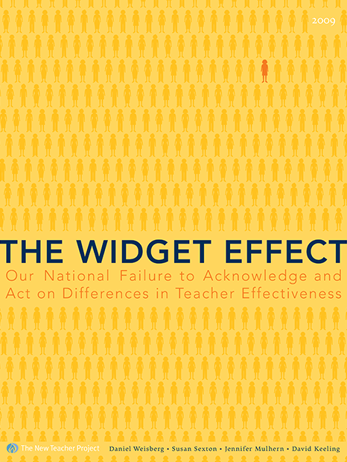
First, we focused on getting great teachers to more students. Then, we started publishing reports on all of the issues we saw getting in the way.
1997 |  |  |  |  | 2002 | 2003 |  |  |  |  | 2008 | 2009 |  | 2011 | 2012 |  |  | 2015
1997 |  |  |  |  | 2002 | 2003 |  |  |  |  | 2008 | 2009 |  | 2011 | 2012 |  |  | 2015
1997 |  |  |  |  | 2002 | 2003 |  |  |  |  | 2008 | 2009 |  | 2011 | 2012 |  |  | 2015
Our work has shifted with our reports to helping school systems efficiently hire quality teachers, improving evaluations to accurately identify great teachers, increasing retention of great teachers, improving professional development… and many, many more.
Notes:
Supporting Great Teaching (2012-2015): Once we could identify great teachers, we asked how we could support them? In The Irreplaceables, we asked the nation's most exceptional teachers what it would take to keep them around -- and two-thirds of great teachers said nobody had even asked them to stay!
In Denver, like in most districts, teachers who want to earn more and play a larger role in their schools have only one option: to leave the classroom and become an administer.
Starting in 2012, TNTP began working with Denver Public Schools to design and pilot Differentiated Roles, a teacher leadership program to empower teachers to advance professionally.
We helped DPS design every aspect of the program and create two new teacher leader roles: team leads and senior team leads.
DPS now runs Differentiated Roles independent of outside support and plans to expand the program to every district-run school in Denver by 2018, reaching over 4,000 teachers.

Slide 5
All of this has taught us that student learning starts with great teachers—but doesn’t end there.
We have a deeper appreciation than ever for how many factors work together to give kids access to a vibrant education.

Slide 6
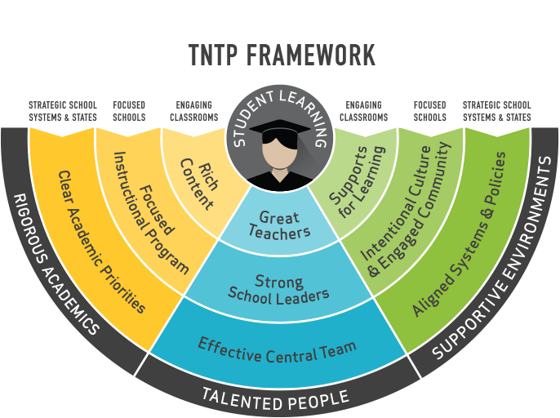
Today, we work at every level of the U.S. public school system to help our partners end educational inequality and achieve their goals for students.
Notes:
Everything we do centers on improving student learning.
We continue to believe that great schools and classrooms start with talented people.
But true leaps in student learning require a more holistic approach.
As we engage ever more deeply with teachers and leaders around the country, we’re thinking more broadly about what our schools can do to ensure students thrive.
Rigorous academics: We’re looking not just at who is teaching, but at what they’re teaching. We know that the best classrooms get results because they’re putting outstanding content in front of students.
Supportive environments: We’re looking at the conditions that set teachers up for success, from the policies and structures in a district, to the culture of their school to the setup of their classroom.
We focus on our partners’ most urgent needs.

Slide 7
In our work with districts and states, we take a comprehensive approach to ensuring that all students have access to great teachers.
4
2
Priorities for the Teaching Profession
GROW ALL TEACHERS
Retained teachers improve over time
Potential Teacher Performance
Current Teacher Performance
1
SUPPLY STRONG NEW TEACHERS
More newly recruited teachers are effective, as measured by student growth
3
REACH DISADVANTAGED STUDENTS
More high-poverty students have effective teachers
Less Effective
More Effective
Persistently less effective teachers leave…
4
… and most effective teachers stay
KEEP TOP TEACHERS
Notes:
Recruitment (1997-2002): When we started out, we focused on getting great teachers to more students. We recruited and trained talented career changers and college graduates to teach in high-need schools and subjects through our Teaching Fellows Programs. Take New York City, as an example:
NYC educates more than 1.1 million students -- that's 1 out of every 50 public school child in the US!
In 2000, NYC was desperate for teachers, filling more than 11,000 positions with uncertified teachers.
In 2000, we worked with the NYC DOE to develop a rigorous teaching fellowship to attract and train qualified new teachers.
Since launching the New York City Teaching Fellows program, nearly 19,000 Fellows have entered city classrooms. Together, they account for one-fifth of the district's math, science and special education teachers.

Slide 8
At the classroom level, we embrace rich content.
Pinellas | Nationwide | New Orleans
Worked in five turnarounds to invest educators in a vision for excellent instruction. | Built Fellows’ content knowledge with new virtual trainings across six subject areas. | Trained 63 experienced teachers and leaders on rigorous instruction.

Slide 9
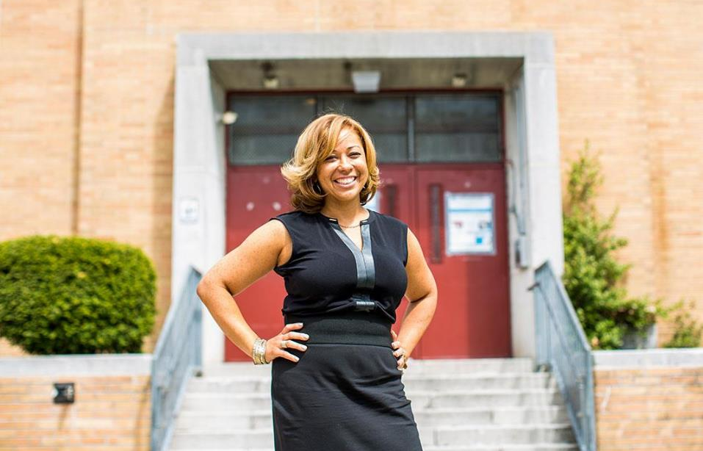
At the school level, we invest in instructional vision.
San Francisco | Nationwide | Springfield
Launched PLUS program to help recruit and train top Bay Area teachers for school leadership. | Helped leaders in 1,300 schools apply Insight and improve culture. | Designed customized turnaround strategy for failing Springfield schools to accelerate student growth.

Slide 10
At the district level, we prioritize student learning.
Boston | Tulsa | Detroit
Surveyed 2,300 teachers to help BPS diagnose barriers to rigorous instruction. | Designed teacher leadership roles in Tulsa to keep top teachers and meet student goals. | Redesigning Detroit central office for school autonomy and accountability.

Slide 11
Across districts, we identify systemic challenges.
Vergara Appeal | Pipeline Studies | Rigor Review
Submitted legal brief profiling two districts with progressive tenure, dismissal, layoff policies. | Analyzed root causes of teacher supply issues across six districts. | Observed 1,000+ classrooms and found only 9% of teachers using standards-aligned instructional practices.

Slide 12
We have a long history of partnering with schools and districts across Texas to solve their most pressing human capital challenges.
Since 2001 |  | CURRENT
Texas Teaching Fellows: Preparation of over 1500 teachers for high need placement areas using a model with proven results on student achievement. Houston ISD: A comprehensive, five-year partnership, resulting in a redesigned talent management system, measurable “trading-up” of teacher talent, and student achievement gains. Fort Worth ISD: Teacher pipeline and human capital system diagnostic, resulting in recommendations that informed strategic plan |  | Dallas ISD: Federally funded partnership to execute a cutting edge, district-based alt cert program, and use it as a model to increase effectiveness of the overall human capital system. RYHT Raising Blended Learners: Technical assistance for five TX districts supporting rigor and student agency in blended learning setting. Texas Teacher Preparation Collaborative: Sharing national perspective on educator preparation policy and conducting focus groups with teachers across the state
Notes:
Texas Teaching Fellows results: In 2013, Mathematica found TNTP-trained secondary math teachers were significantly more effective than other novice teachers—generating roughly 4.5 months more learning for students. A 2013 UT Austin study showed that TNTP-trained teachers in TX had significantly better student outcomes in math as compared to other preparation pathways
Houston ISD results:
We helped HISD design a new teacher evaluation system—engaging more than 4,000 stakeholders in the redesign—that gives teachers regular feedback and generates unprecedented data on teacher performance
In 2014, 45 percent of teachers had development areas identified on their evaluations—up from 3 percent before the new evaluation system
In 2010, there were no leadership opportunities for teachers. By 2014, 450 top teachers served in leadership roles.
1 in 4 schools acted on teacher performance data and hired better teachers in 2013, schools that hired better teachers saw student achievement gains in math and reading

Slide 13
Today, TNTP stands for so much more than new teachers.
We are partners for change in public education. We help school systems achieve their goals for students.

Slide 14
For news, updates, and to share our latest work with your friends and contacts, join our online community.
 | tntp.org
 | facebook.com/thenewteacherproject
 | twitter.com/tntp
 | linkedin.com/company/tntp

