Slide 1

Effects of Poverty on the Brain and Learning
Martha S. Burns, PH.D.
Joint Appointment Professor
Northwestern University
.

Slide 2
We have known that income level negatively impacts cognitive functions for over a decade

Slide 3
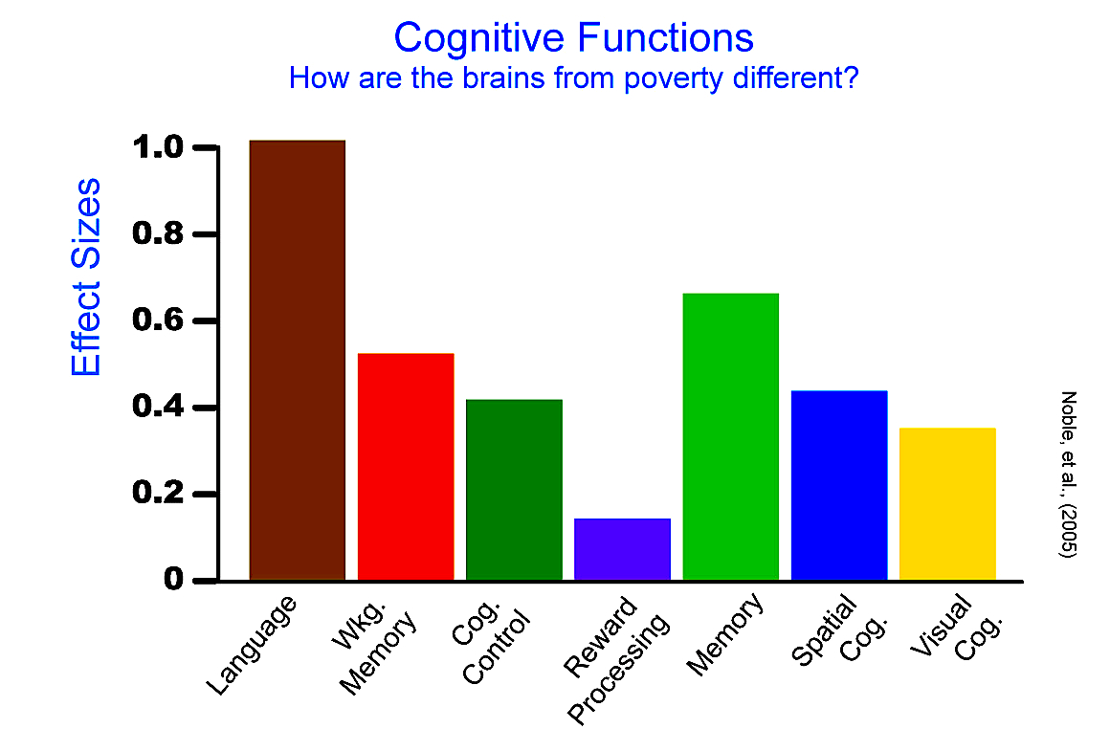
There are links between family income and memory and attention

Slide 4
But newer research is specifying why and how the impact of poverty affects learning

Slide 5

Family income, parental education and brain structure in children and adolescents Noble, et. al. Nature Neuroscience 30 March 2015
Among children from lower income families,
  small differences in income were associated with relatively large differences in surface brain area
Among children from higher income families, similar income increments were associated with smaller differences in surface area.

Slide 6
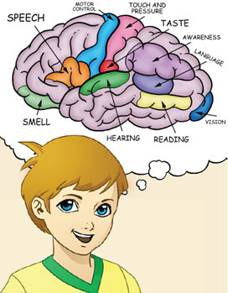
Brain structure and poverty (Noble et al, 2015)
Brain Structure and income level relationships were most prominent in regions supporting
language
reading,
executive functions
spatial skills

Slide 7
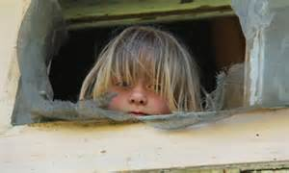
Noble et al 2015 Conclusion
This research implies that income relates most strongly to brain structure among the most disadvantaged children.

Slide 8
April 2015 – Dr. John Gabrielli’s Lab at MIT
Published research that corroborates Noble 2015 and clarifies the income/achievement gap
Showing that High Income versus Low Income achievement differences directly correlate to measures of cortical thickness in adolescents

Slide 9
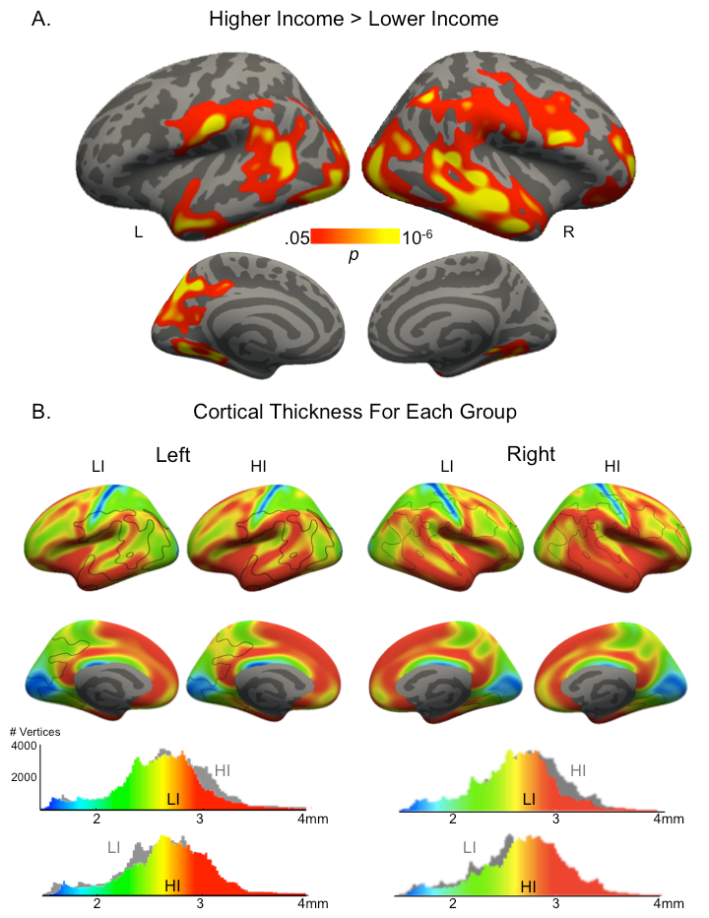
Neuroanatomical Correlates of the Income-Achievement
Gap
Mackey, A. P., A. S. Finn, J. A. Leonard, D. S. Jacoby-Senghor,
M. R. West, C. F. O. Gabrieli, and J. D. E. Gabrieli. (2015)
“Neuroanatomical Correlates of the Income-Achievement Gap.”
Psychological Science (April 20).

Slide 10
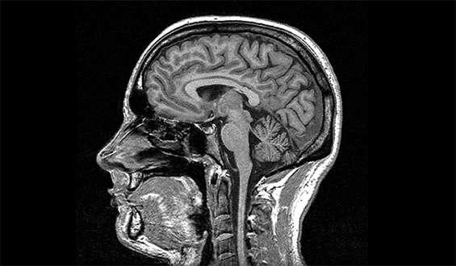
Corroborated by Pollak et al, in June
20 percent of the gap in test scores between poor children and middle-class children may be a result of poor brain development in the frontal and temporal lobes
Pollak, S., et al. (2015) JAMA Pediatrics

Slide 11
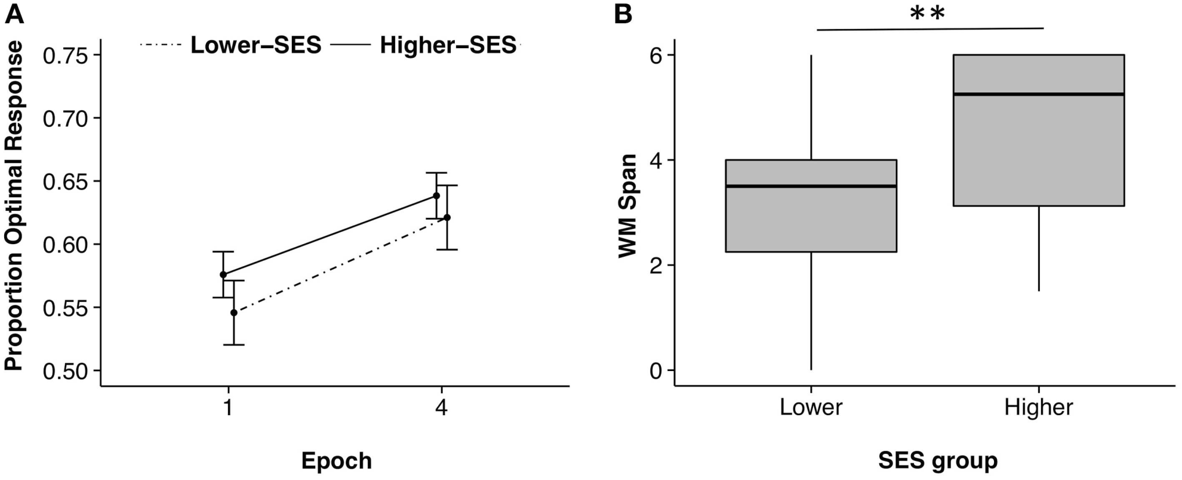
In October, differential effects of SES on kinds of memory (working versus procedural memory)
Procedural Memory (probabilistic learning)
Working Memory
Leonard, J., Mackey, A., Finn, A. & Gabrielli, JE (2015) Front. Hum. Neurosci., 08 October

Slide 12
So… SES does not affect intelligence or ability to learn in general
Rather SES affects those types of learning important for academic success
But, why????

Slide 13
A key feature is toxic stress associated with poverty

Slide 14
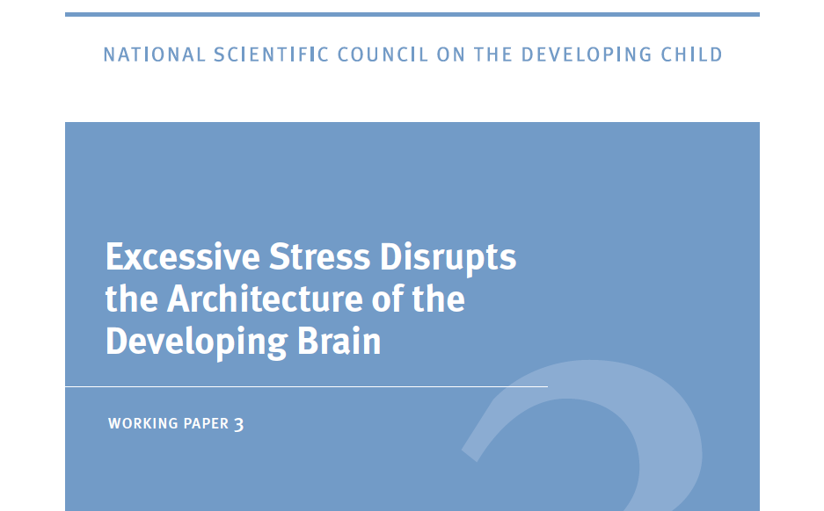

http://developingchild.harvard.edu/resources/wp3/

Slide 15
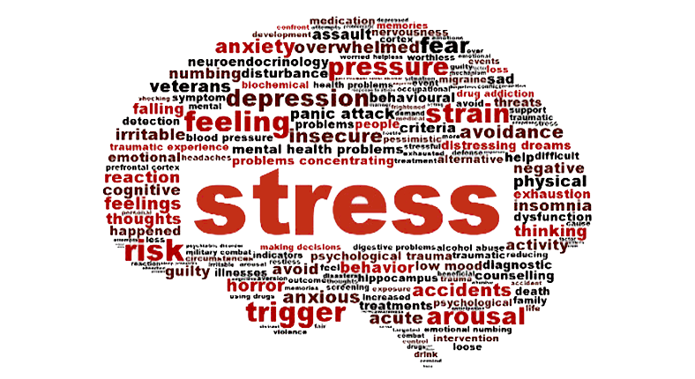
Effects on Brain Development
The neural circuits for dealing with stress are particularly malleable (or “plastic”) during the fetal and early childhood periods
  the regions of the brain involved in fear, anxiety, and impulsive responses may overproduce neural connections
  those regions dedicated to reasoning, planning, and behavioral control may produce fewer neural connections

Slide 16

Damage to health and well-being
Extreme exposure to toxic stress changes the stress response system
  Responds at lower thresholds to events that might not be stressful to others,
  Activates more frequently and for longer periods than is necessary, like revving a car engine for hours every day.
  This wear and tear increases the risk of stress-related physical and mental illness later in life

Slide 17
Adverse Childhood Experiences (ACES)
(n =1007) [Jimenez et al, 2016)
Variable % (No.)
Child maltreatment
Psychological 16 (162)
Neglect 13 (132)
Physical 15 (154)
Sexual 0.6 (6)
Household dysfunction
Maternal
depression 12 (121)
Substance use 15 (149)
Incarceration 18 (181)
Violence toward
mother 11 (111)
Total ACEs
0 45 (451)
1 27 (275)
2 16 (158)
3 8 (84)
4 3 (25)
5 1 (11)
6 0.3 (3)
Jimenez et al. Adverse Experiences in Early Childhood (ACES) and Kindergarten Outcomes
PEDIATRICS Volume 137, number 2 , February 2016

Slide 18
Study Involved A Racially Balanced Population (Jimenez et al, 2016)
African American

Slide 19
Table 3 Teacher Ratings of Below Average Academic Skills – percentages (Jimenez et al, 2016)

Slide 20
Table 5.Teacher Ratings of Behavior – Percentages (Jimenez et al, 2016)

Slide 21
Conclusion (Jimenez et al, 2016)
Children experiencing adverse childhood experiences (ACES) places students at significant risk for
  Poor school achievement
  And is associated with poor health

Slide 22


ELL
Double Jeopardy
ELL enrollment in schools more than doubled between 1997 and 2008 (National Clearinghouse for English Language Acquisition, 2010).
Notes:
Giving a set of directions. Deer in the headlights look.
Go to your desk.
Take out your math book.
Number your paper from 1-20.
Do the odd exercises on p.41

Slide 23
Hispanic children constitute an urgent demographic imperative (Garcia and Jensen, 2009)
Hispanic children, who speak Spanish as their first language (L1), make up the largest proportion of ELL students in today’s schools (U.S. Census Bureau, 2010).
  (a) Hispanics are the largest and fastest growing minority group in the United States;
  (b) disproportionately high numbers of Hispanic children live in poverty (Chau, Thampi, & Wight, 2010)
  (c) Hispanic children, as a group, struggle with relatively poor educational achievement

Slide 24
Disadvantages
ELL students may face
Parenting challenges associated with non-conventional work hours
Cognitive, language and brain effects of poverty – see especially Noble, 2005 and 2015
Cognitive, language and brain effects of stress

Slide 25
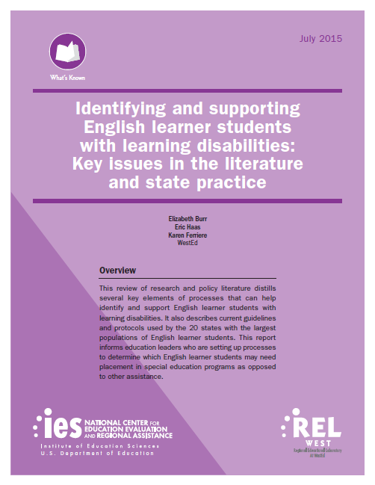
ELL students often also have a high proportion of unidentified learning disabilities
Standardized test scores alone cannot distinguish between learning disabilities and other factors
  such as a student’s low level of proficiency in his or her first language,
  limited prior schooling, and
  low levels of English proficiency, which may cause an English learner student to perform below standards

Slide 26
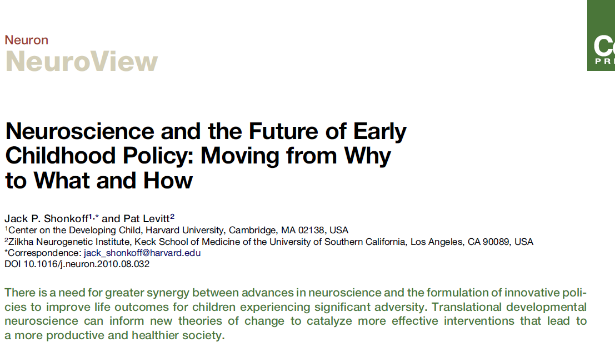

Slide 27
Solutions: Neuroscience – Moving from Why to What and How
  Positive experiences after infancy have been shown to compensate to some degree for the negative behavioral consequences
  Being exposed to an environment rich in opportunities for exploration and social play,
  Caring and positive relationships with adults
Computer activities designed to target the skills that are impacted can turn around some effects of poverty
  Fast ForWord exercises, because of their specific emphasis on language, attention and memory are particularly effective and offer a cost effective valuable solution

Slide 28
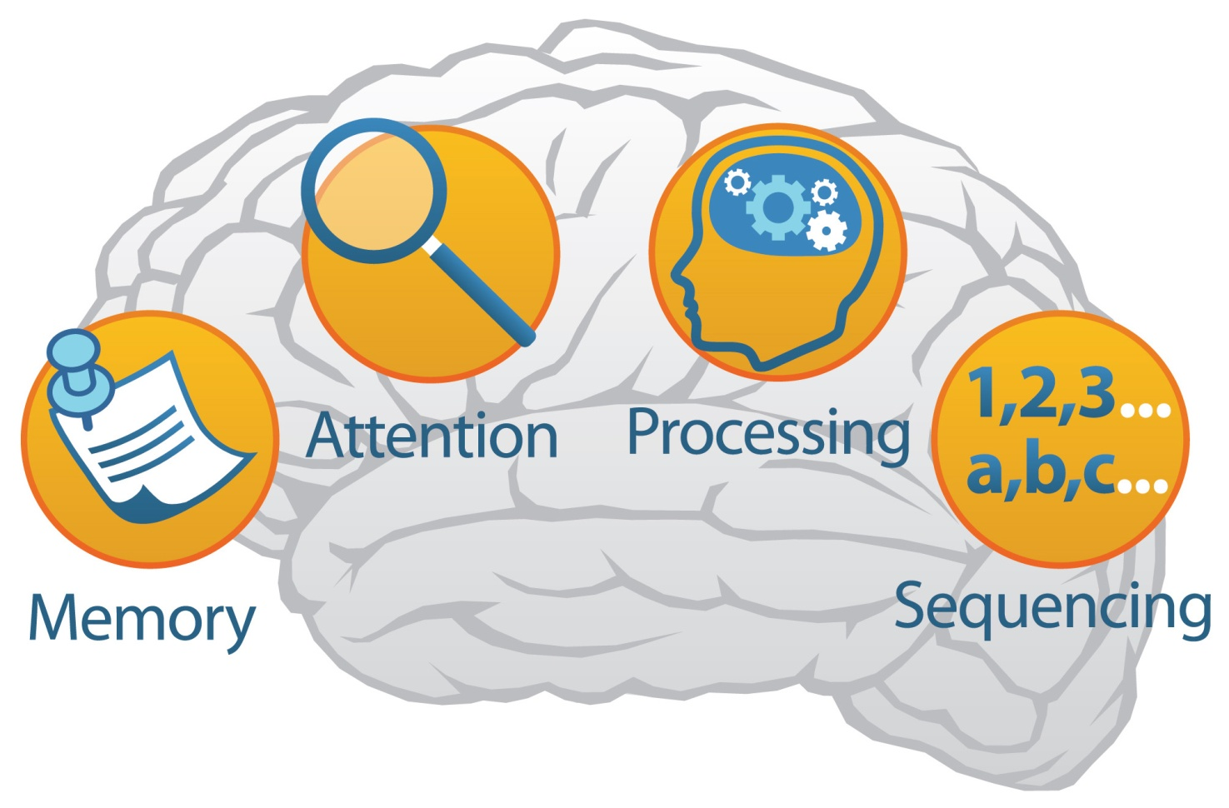
The Role of Neuroscience Technology
Well designed neuroscience-based technology
builds the underlying capacities that are reduced in some children of poverty or with learning issues
Executive Function
+
Cognitive Skills

Slide 29
And the Brain Structures affected most by Poverty
LANGUAGE AND READING AREAS
ARE ACTIVATED AFTER SIX WEEKS OF FAST FORWORD TRAINING
Typically reading children Reading Impaired Children Reading Impaired Children
before remediation after remediation
Gabrieli, 2009
Left anterior inferior frontal gyrus IFG
Angular Gyrus AG
Visual Word Form Area
Left Medial Temporal Gyrus

Slide 30
Attentional Skills are also improved after FFWD
Courtney Stevens, et al. B R A I N R E S E A R C H 1 2 0 5 ( 2 0 0 8 ) 5 5 – 6 9

Slide 31
In a large urban district with high poverty and ELL students Accelerating Growth – District Wide
80
75
70
65
60
55
50
45
78%
Percent of Fourth Graders
Basic or Above (Initial Testers)
53%
Fast ForWord
Reading Assistant
2003 2004 2005 2006 2007 2008 2009
2010
Year
St. Mary Parish School District
State
Notes:
Let me show you a school district that made the choice to eliminate the achievement gap - St. Mary Parish Public School District in Louisiana. In 2005, the Superintendent, Dr. Don Aguillard was hired to transform this school district after years of struggle. There were 8 schools on the verge of state takeover. He made a choice and decided that Fast ForWord was the right tool to accelerate learning for his district. This graph shows the percentage of fourth graders each year who achieved a performance rating of Basic or Above on their LEAP English Language Arts test. The green line represents 4th graders from St. Mary Parish, and the orange line represents 4th graders across the state of Louisiana. By serving ALL of their 4th grade students, not just struggling readers, the district improved from 53% to 78% of students at Basic or Above, and the district surpassed an improving state average within 2 years.
You will also note that between 2009 and 2010 the district experienced another significant jump – this was due to the implementation of Reading Assistant and the power of both programs working together.
31

Slide 32
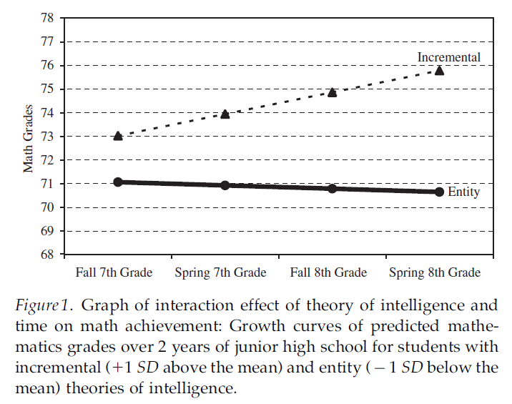
The Secret to Raising Smart Kids
Carol S. Dweck, Scientific American, 2013
Growth Mind-Set
Fixed Mind-Set
Students who believe intelligence is malleable (growth mind-set) earned higher math grades in the fall of 7th grade than those who believe in static intelligence (fixed mind-set) even though the groups had equivalent math achievement test scores in the sixth grade. From Implicit Theories of Intelligence Predict Achievement. LS Blackwell et al., CHILD Devel., Vol. 78, No. 1
Blackwell, LS et al (2007)

