Slide 1
Data Use at KIPP
Educating the Children of Poverty
September 12, 2016
Austin, TX

Slide 2
KIPP is now serving nearly 80,000 students across 200 schools

Slide 3
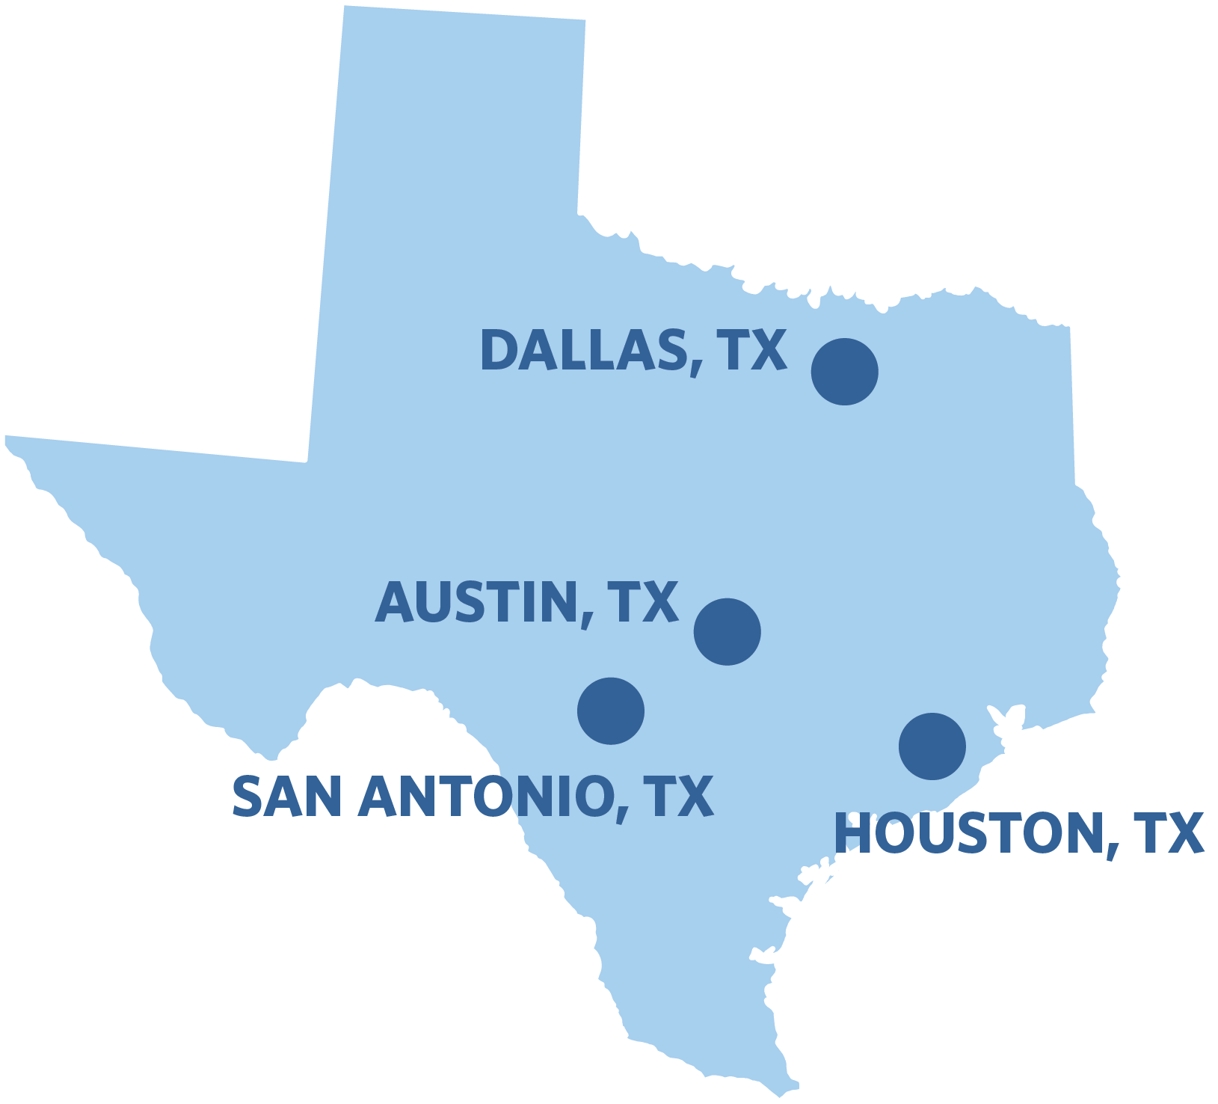
~30% of students are in Texas spread across four regions
~30% of KIPP Students
4 Regions
47 Schools
72% Latino & 25% African American
89% Free/Reduced Price Lunch
37% ELL
6% SPED
51% of KIPPsters, tracking from 8th grade, have graduated from college
Notes:
Note: # Schools is as of Fall 2016. All Demographic data is as of Fall 2015.

Slide 4
We support our leaders in data decision making across a multi-prong approach
1- Shared use of our Healthy Region and Schools Framework and Academic Strategy Pyramid
2- Embedding Data Decision Professional Development Throughout our Leadership Programming
3- Data is a Key Element Throughout our Leadership Readiness Criteria

Slide 5
HSR Framework & Academic Strategy Pyramid

Slide 6






We utilize our Healthy Schools & Regions Essential Questions
Question 1
Are we serving the children who need us?
Question 2
Are our students staying with us?
Question 3
Are our students progressing and achieving academically?
Question 4
Are our alumni climbing the mountain to and through college?
Question 5
Are we building a sustainable people model?
Question 6
Are we building a sustainable financial model?
Notes:
Simple, sticky 6 questions. Ensures everyone across our network uses the same frame for evaluating health. Also ensures we are looking beyond only acadeics.

Slide 7
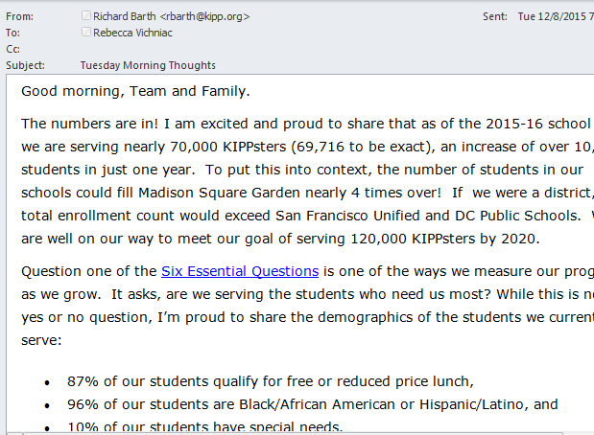
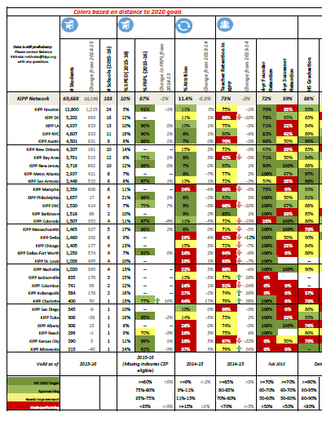
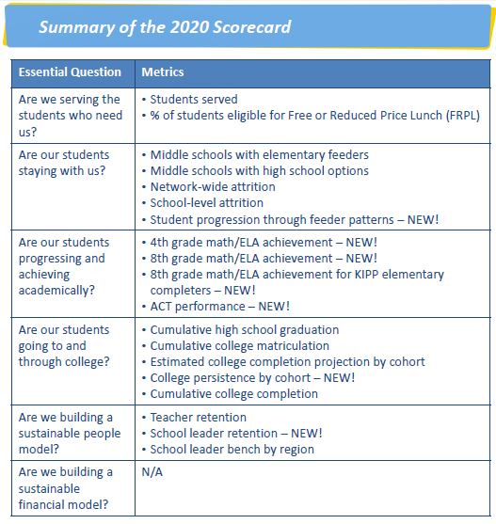
Our HSR Framework guides how we measure our performance
Notes:
We use this framework to measure our performance year over year. It guides everything from our CEO’s weekly messages to the whole KIPP network, to our dashboards for our Board, to the dashboards we share with network leadership

Slide 8
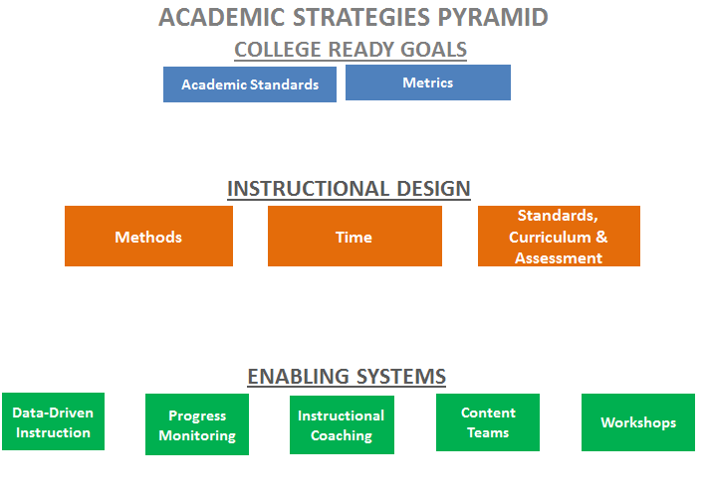
Our academic strategy pyramid
Notes:
Similarly we focus our academic systems around our academic strategy pyramid. Two of our enabling systems are around Data Driven Instruction and Progress Monitoring.

Slide 9
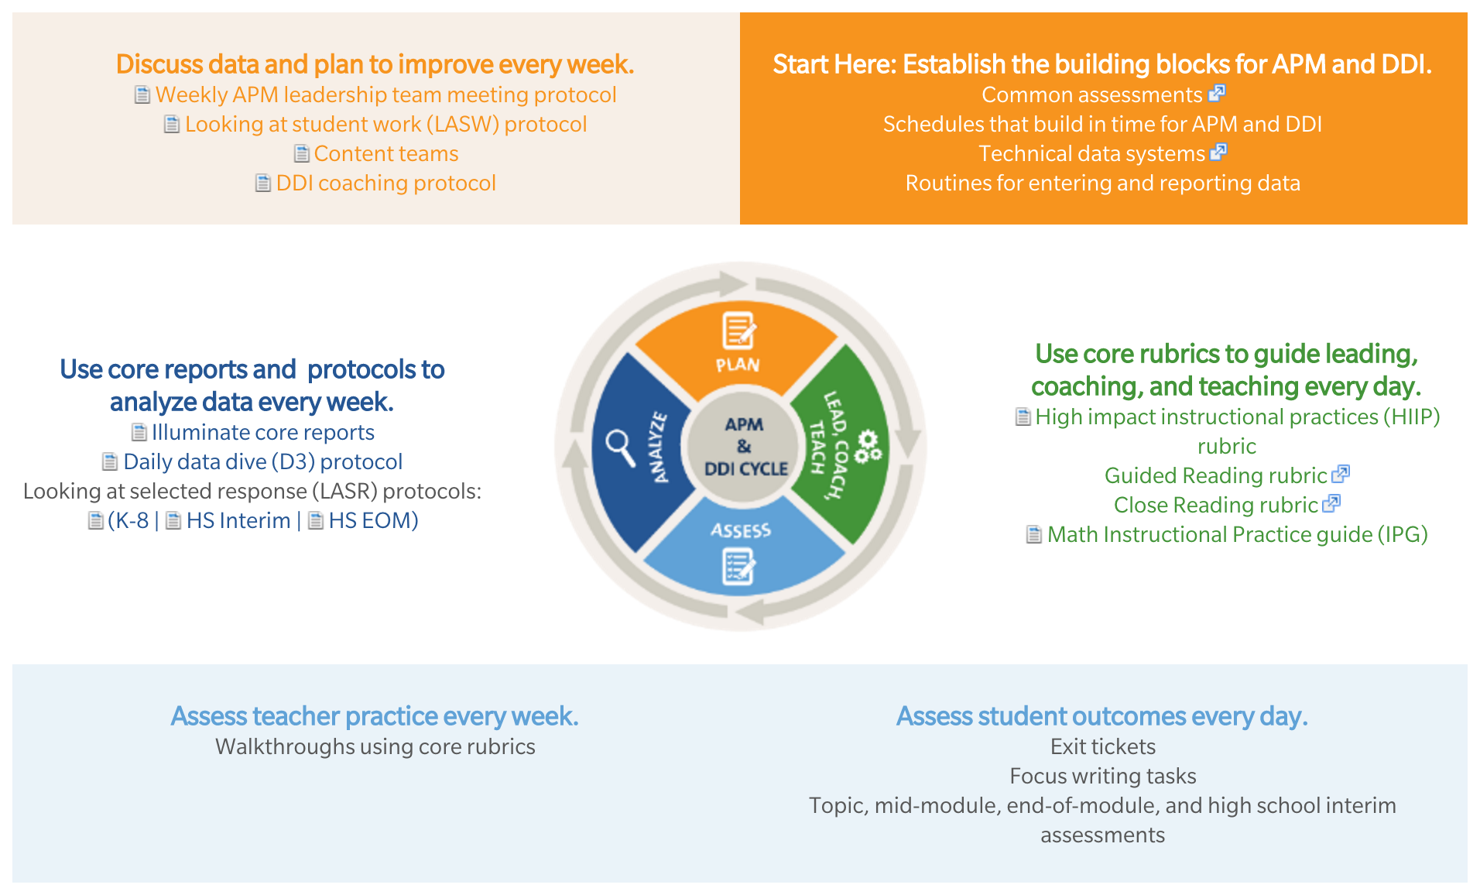
We provide a suite of toolkits to support these enabling systems
Notes:
We recently published a suite of tools to support your work to monitor academic progress and implement data-driven instruction.
The APM and DDI cycle includes four continuous steps:
Lead, coach, teach: Use core rubrics to guide leading, coaching, and teaching every day.
Assess: Assess student outcomes every day and teacher practice every week.
Analyze: Use core reports and protocols to analyze data every week.
Plan: Discuss data and plan to improve every week.
Academic progress monitoring (APM) is using data to improve teacher practice and student outcomes. It answers the questions, "What student outcomes are our efforts producing? How do these compare to our goals? How can we improve?"
Data-driven instruction (DDI) IS ACADEMIC PROGRESS MONITORING with individual student data at the classroom level.
DDI answers more specific questions, "What do individual KIPPsters know and not know? What are student errors and misconceptions? What will we re-teach in the next 24-48 hours?"

Slide 10
Professional Development

Slide 11
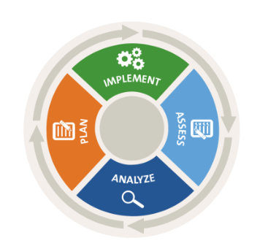
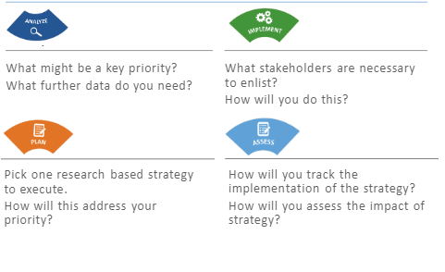
Strategic School Leadership
Year-long course on data driven leadership for assistant principals at KSLP
At KSLP, we developed “Strategic School Leadership” a five-part course for assistant principals to learn how to integrate the academic strategies with progress monitoring to achieve outcomes for students and our schools.
Break it down!

Slide 12
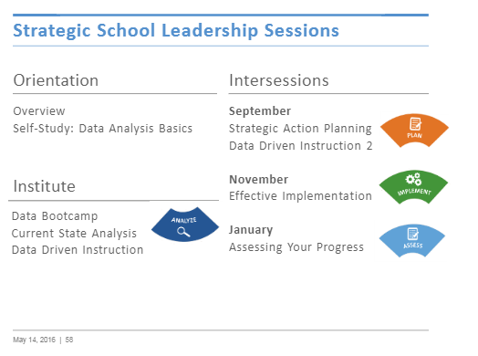
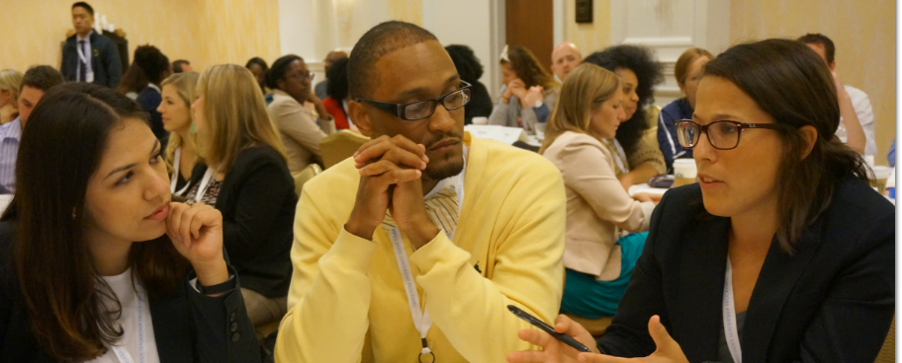
We teach it as a five part course….

Slide 13
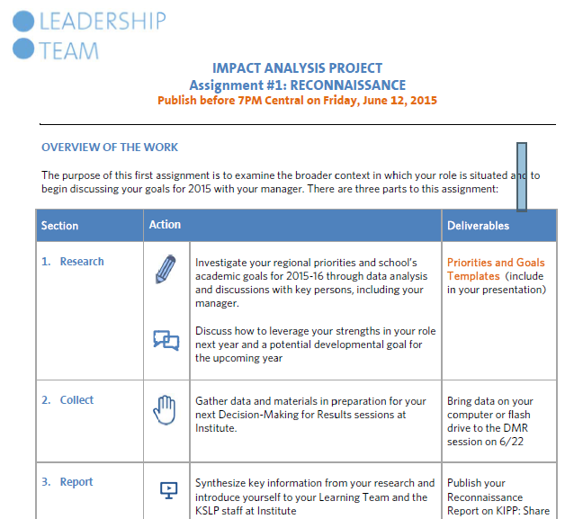
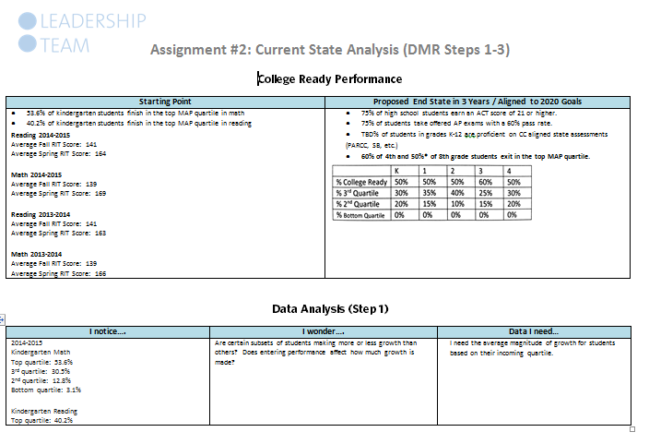
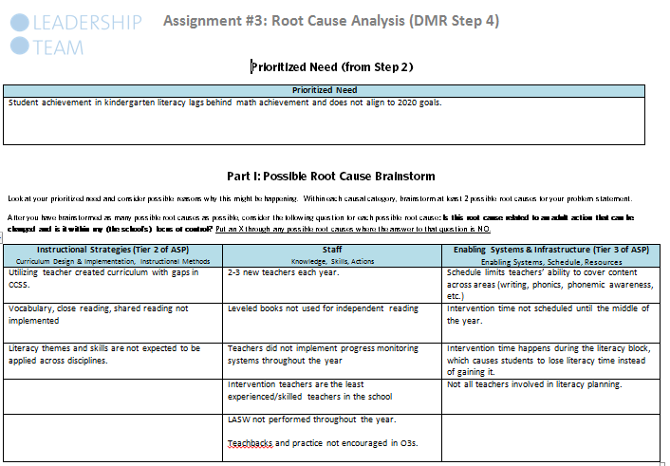
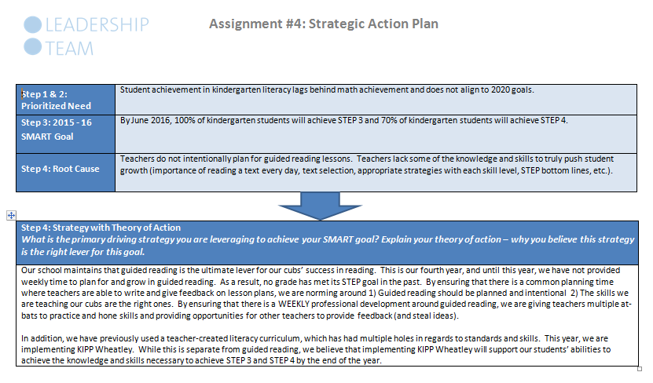
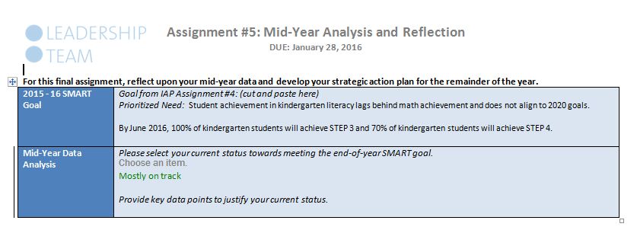
…and pair it with a applicable assignments so leaders can practice what they learn at KSLP

Slide 14
Similar programming exists throughout all of our cohorts
Fisher Fellowship Goals
Leading for Learning Action #1: Vision & Goals: Set ambitious school-wide vision and goals that lead students on a path to and through college.
Leading for Learning Action #2: Plan & Prioritize: Relentlessly plan and prioritize to achieve goals.
Leading for Learning Action #5: Hire & Retain: Hire and retain the best of the best.
Leading for Learning Action #6: Instructional Leadership: Build knowledge and expertise in effective instructional design and academic standards.
Adaptive Leadership Skills: Demonstrate an understanding of self as a leader, impact on others, and overall leadership philosophy.
Coaching: Engage in coaching sessions to drive deeper understanding of self, leverage strengths, and drive growth.
Notes:
We see similar programming throughout our programming. For example, Fisher Fellows who are in a year long program before they open new schools, have two of their six program goals integrating data and DDI

Slide 15
Leadership Readiness Criteria

Slide 16
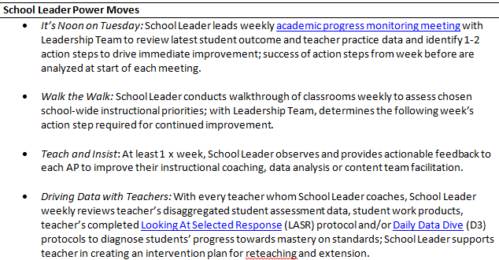
Progress monitoring and data driven instruction are two of the four power moves for all of our school leaders

Slide 17
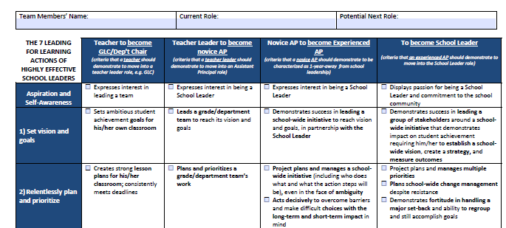
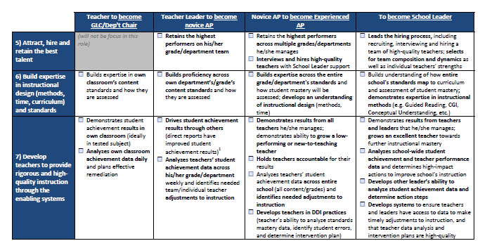
Leadership readiness criteria incorporates goal setting and data analysis
Notes:
Our readiness criteria for leaders as they progress from a teacher to grade level chair to assistant principal to school leader has data embedded throughout

