Slide 1
K-12 Educational Outcomes for Texas Children w/ Particular Focus on Poverty How Do We As a State Scale Those Efforts That Are Working and Change Incentives/Reduce Barriers?

Slide 2
What the Commit! Partnership Is
Education collective impact backbone, the largest of its kind among 60+ members of the StriveTogether national network, serving the 750,000+ students (PreK thru College) across Dallas County
Key Facts:
Independent 501(c)(3) founded in 2012 out of initiative by Dallas Regional Chamber and Dallas Mayor Rawlings
Staff of ~20 dedicated FTEs and ~$3M annual budget singularly focused on helping move biggest levers driving systemic change affecting outcomes
5 initial programmatic focuses:
Early Childhood Education
Middle Grades Success
Postsecondary Attainment
Educator Pipelines
Data “Democratization”
Work with ~185 partners across sectors including ISD’s, higher ed, foundations, nonprofits, businesses, and civic entities

Slide 3
The Texas 60-by-30 State Goal Is At Risk; We Need Nearly 1M More Young Adults with a Postsecondary Credential
Educational Attainment of Texas 25-34 Year-Olds
Represents 996K 25-34 Year-Olds
34% of young adults with degree
Source: U.S. Census Bureau, 2014 American Community Survey 1-Year Estimates

Slide 4
…Which Result in a Challenged Cradle-To-Career Pipeline for Texas Reflecting Inadequate Educational Outcomes
Pre-K Access Gap 14%
State of Texas performance (5.3M public PK-12 students, 59% eco dis)
Dallas County performance where TX data unavailable (494K public PK-12 students, 72% eco dis)
Pre-K Quality Gap
29%
Noteworthy gaps
College Access Gap
College Retention Gap
College Completion Gap
Eligible
Pre-K4 Students Enrolled¹
Kinder Ready
3rd Reading²
4th Math²
8th Science²
Algebra I²
College Ready³
HS Grad %⁴
College Enroll-ment⁵
College
1st Yr Persistence⁵
College 6-Yr Comple-tion⁵
~ # of Students Not Proficient
230,000
244,000
223,000
226,000
253,000
37,000
Source: 1)Texas Education Agency (TAPR) 2) Achievement levels represent percentage of students achieving Postsecondary Readiness standard (3rd thru Algebra 1) on 2014 STAAR exams. 3) Source: Texas Education Agency (TAPR). Per TEA, SAT/ACT college readiness equivalent to 1110 on SAT Reading/Math subject tests or 24 on ACT. Minimum 100 graduates. 4) TEA: Federal Graduation Rate calculation from accountability standards. 5) Postsecondary data: National Student Clearinghouse and Texas Higher Education Coordinating Board

Slide 5
The Education Pipeline Is Falling Short Of The Demand—253,000 High School Graduates Are Not College Ready
Texas, 2015: 5.3M public PK-12 students, 59% Economically Disadvantaged
Eligible
Pre-K4 Students Enrolled¹
College Enroll-ment⁵
College
1st Yr Persistence⁵
College 6-Yr Comple-tion⁵
3rd Reading²
8th Science²
College Ready³
4th Math²
Algebra I²
HS Grad %⁴
% TX Students Meeting Benchmark
# of TX Students Not Meeting Benchmark
Source: 1)Texas Education Agency (TAPR) 2) Achievement levels represent percentage of students achieving Postsecondary Readiness standard (3rd thru Algebra 1) on 2014 STAAR exams. 3) Source: Texas Education Agency (TAPR). Per TEA, SAT/ACT college readiness equivalent to 1110 on SAT Reading/Math subject tests or 24 on ACT. Minimum 100 graduates. 4) TEA: Federal Graduation Rate calculation from accountability standards. 5) Postsecondary data: Texas Higher Education Coordinating Board. Enrollment for HS class of 2014 enrolled within 1 year of HS graduation. Persistence for HS class of 2012. Completion for 2009 college enrollees and only includes full-time enrolled students. All postsecondary data slightly under-stated (relatively by 10%-20%) as data does not include out-of-Texas enrollees

Slide 6
And TX Public PK-12 Enrollment Growth Accounts for 70% of the U.S. Growth… What Happens Here Matters
Public Pre-K-12 Enrollment
52 M
Rest of U.S. growth
51 M
Texas growth
+0.3K
50.1 M
Texas now educates 1 in 10 U.S. children 18 years or younger
50 M
+0.7 M
49.1 M
Enrollment
49 M
48 M
47 M
46 M
45 M
Source: To fill in

Slide 7
Solving the Pre-K Enrollment and Pre-K Thru 3rd Quality Gaps Only 39% of TX Students Answer ~75% of Questions Correctly on 3rd Grade Reading Assessment
A troubling 47% drop-off exists between students who attend Pre-K today and the number who currently pass the 3rd grade STAAR reading assessment at the post secondary level 4 years later
Eligible
Pre-K4 Students Enrolled
3rd Reading

Slide 8
Fewer Than 50% of Students Are on a Postsecondary Ready Pace in Algebra I
Subsequent academic achievement in math and science never materially exceeds that seen in early grades math, with over 200,000 students annually failing to meet postsecondary pace proficiency levels (63% of questions answered correctly)
4th Math
8th Science
Algebra I
~ # of Students Not Proficient
244,000
223,000
226,000

Slide 9
TX is Near the Top of U.S. in High School Graduation Rates—Nearly 90% Do So—But Are Our Graduates Ready?
Just 17% of Texas public high school students graduating annually now achieve a college ready SAT or ACT score, based on TX state criterion, with over 250,000 students annually inadequately prepared for their postsecondary education…often requiring subsequent remediation which the student must pay for but receives no college credit for doing so
College Ready
HS
Graduation %

Slide 10
And We Will Need To Alleviate the Negative Effects of Child Poverty, With 4 TX Cities in the Top 20
Child poverty rates among 25 largest cities:
City | Percent
1. Cleveland | 58%
2. Detroit | 57%
3. Memphis | 47%
4. Milwaukee | 42%
5. Fresno | 41%
6. Atlanta | 38%
6. Dallas | 38%
8. Miami | 37%
8. Philadelphia | 37%
10. Houston | 35%
10. Tucson | 35%
12. Nashville | 34%
12. Phoenix | 34%
14. Baltimore | 33%
14. Boston | 33%
14. Chicago | 33%
14. Indianapolis | 33%
14. Los Angeles | 33%
19. Minneapolis | 32%
20. Columbus | 31%
20. El Paso | 31%
20. San Antonio | 31%
23. New York City | 30%
23. Tulsa | 30%
25. Long Beach | 29%
Poverty is growing significantly and becoming more concentrated; Dallas, Houston, San Antonio and El Paso currently place 6th, 10th, 20th and 20th among the 50 largest U.S. cities in child poverty rankings, with continued weak postsecondary outcomes likely to only exacerbate problem
Source: To fill in

Slide 11
Poverty is NOT Destiny: Wide Spreads in STAAR Achievement at MINIMUM Std. Regardless of Student’s Economic Disadvantaged Status or Campus Poverty % (But Concentrated Poverty is Disadvantageous For ALL Students)
Source: 2015 TEA STAAR data at minimum passing standard

Slide 12
Poverty is NOT Destiny: Wide Spreads in Achievement at POST SECONDARY Std. Regardless of Student’s Economic Disadvantaged Status or Campus Poverty % (But Concentrated Poverty is Disadvantageous For ALL Students)
Source: 2015 TEA STAAR data at post secondary Final Level 2 standard

Slide 13
Poverty is NOT Destiny: Wide Spreads in URBAN Achievement at MINIMUM Std. Regardless of Student’s Economic Disadvantaged Status or Campus Poverty % (But Concentrated Poverty is Disadvantageous For ALL Students)
Source: 2015 TEA STAAR data at minimum passing standard, Urban defined as Dallas, Harris, Tarrant, Travis, Bexar and El Paso County

Slide 14
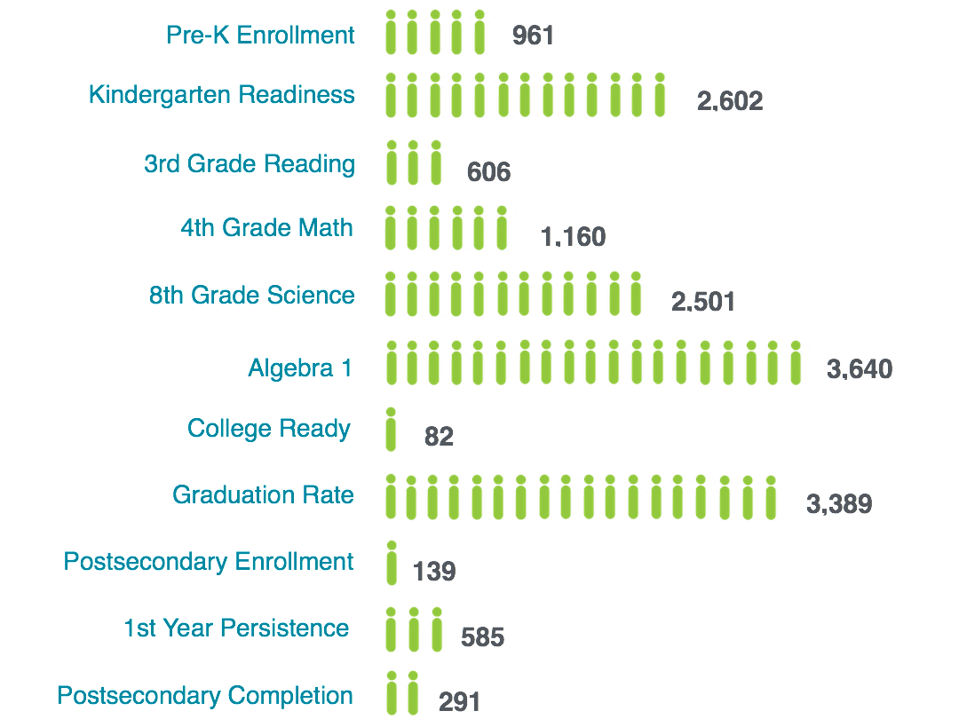
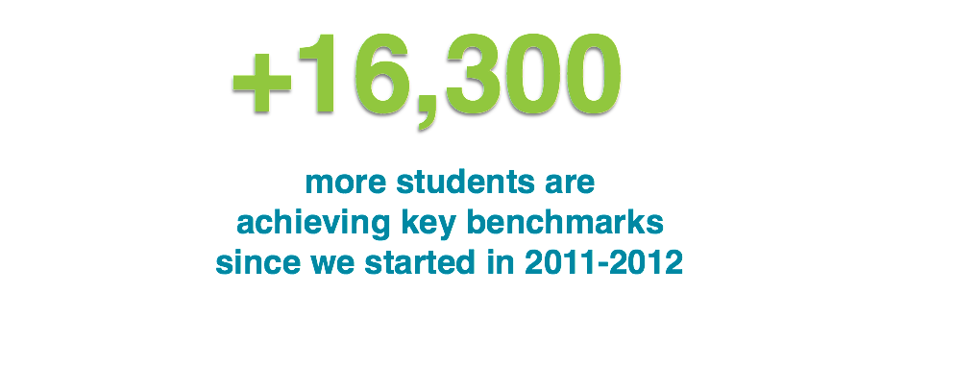
Since 2011-12 Inception, 16,300 More Students are Achieving Key Benchmarks in Dallas County

Slide 15
Progress in Reducing No. of Bottom 5% Schools Dallas County Has Led the Way Over the Last 2 Years
Source: Texas Education Agency State Accountability Ratings. Enrollment based on 2014-2015.

Slide 16
Dallas ISD Has Led the State’s Six Major Urban Districts in Reducing the Number of Students Attending an IR Campus, Cutting Their IR Enrollment by 47% in Two Years
In 2014 Both Dallas ISD and Houston ISD Had 43 IR Campuses…
Dallas ISD Has Since Cut Its Number of IR Campuses and Corresponding Students in HALF
Metro Urban ISDs | School Year Ending May 2014 |  | School Year Ending May 2016 |  | 2014-2016 Difference (Two Years)
 | # IR Camp. | # Students | # IR Camp | # Students | # IR Camp | # Students | % Students
Dallas ISD | 43 | 30,396 | 22 | 16,187 | -21 | -14,209 | -47%
Houston ISD | 43 | 30,657 | 40 | 32,820 | -3 | 2,163 | 7%
Fort Worth ISD | 24 | 15,247 | 22 | 13,717 | -2 | -1,530 | -10%
S. Antonio ISD | 17 | 12,333 | 20 | 11,341 | 3 | -992 | -8%
Austin ISD | 8 | 4,465 | 8 | 4,590 | 0 | 125 | 3%
El Paso ISD | 1 | 41 | 2 | 1,536 | 1 | 1,495 | 3646%
Total | 136 | 93,139 | 114 | 80,191 | -22 | -12,948 | -14%
Source: Texas Education Agency State Accountability Ratings. Enrollment based on 2014-2015.

Slide 17
Expanding Access to Quality Early Childhood to Create Solid Foundation 100% Kinder Readiness Could More Than Double 3rd Grade Literacy Rate
District wants to serve incremental ~15,000 low income/ELL 3 and 4 year olds both directly and in partnership with quality private providers
2.3x
3.2x
Source: Dallas ISD English reading assessments for Fall 2011/Fall 2015 in measuring K readiness using 184 cut score (40th percentile). STAAR test from Texas Academic Performance Reports from TEA used in Spring 2015 to measure 3rd grade reading at standard equivalent to being on grade level for college ready pace

Slide 18
Progress in Growing Pre-K Enrollment and K Readiness DISD Board Has Mandated Serving All 3’s and 4’s by 2025
Pre-K Source: Texas Academic Performance Reporting system, 2012-2015. To calculate % of eligible children enrolled in Pre-K, actual Pre-K students are calculated as a percentage of estimated Pre-K need. Pre-K need is determined by using the free or reduced lunch 1st grade population to determine the number of 4-year olds in need of Pre-K.
KR Source: Dallas ISD. The percent of students deemed Kindergarten Ready based on the early literacy Istation assessment administered at the beginning of the year in Kindergarten. The values presented are based on criterion data, not normed tier data.

Slide 19
Across DFW, Both Teacher Turnover and % of Teaching Force That is Composed of Beginning Teachers Has Been Steadily Growing Since 2010-11
Avg. Teacher Turnover %
% Beginning Teachers
District | 2012 | 2013 | 2014 | 2015
Cedar Hill | 24 | 26 | 27 | 32
DeSoto | 10 | 19 | 26 | 25
Duncanville | 9 | 19 | 18 | 22
Fort Worth ISD | 9 | 19 | 18 | 22
Dallas ISD | 12 | 18 | 22 | 21
Irving ISD | 13 | 21 | 21 | 21
Richardson | 12 | 18 | 17 | 19
Grand Prairie | 13 | 18 | 17 | 19
Carrollton FB | 12 | 16 | 16 | 17
Coppell | 9 | 16 | 17 | 16
Garland | 9 | 12 | 14 | 15
Highland Park | 13 | 16 | 12 | 15
HEB | 9 | 12 | 11 | 14
Mesquite | 10 | 12 | 14 | 14
Mansfield | 7 | 11 | 12 | 12
Plano ISD | 11 | 11 | 13 | 12
Arlington ISD | 10 | 11 | 12 | 11
Keller ISD | 12 | 12 | 10 | 11
Average | 11 | 16 | 17 | 18
District | 2012 | 2013 | 2014 | 2015
Richardson | 5 | 7 | 10 | 8
Dallas ISD | 5 | 9 | 13 | 14
DeSoto | 5 | 9 | 13 | 14
Cedar Hill | 5 | 10 | 8 | 13
Mansfield | 2 | 4 | 3 | 11
Duncanville | 5 | 9 | 14 | 11
Fort Worth ISD | 5 | 9 | 14 | 11
Grand Prairie | 5 | 6 | 12 | 10
Keller ISD | 2 | 5 | 4 | 9
Irving ISD | 4 | 11 | 11 | 9
Carrollton FB | 5 | 9 | 8 | 8
Coppell | 2 | 5 | 7 | 7
Mesquite | 6 | 7 | 7 | 7
Arlington ISD | 5 | 9 | 8 | 7
Plano ISD | 14 | 4 | 4 | 5
HEB | 3 | 4 | 3 | 5
Garland ISD | 3 | 5 | 5 | 5
Highland Park | 3 | 3 | 2 | 2
Average | 4 | 7 | 8 | 10

Slide 20
Across Texas, Both Teacher Turnover and % of Teaching Force Who are Beginning Has Been Steadily Growing Since 2010-11
Avg. Teacher Turnover %
% Beginning Teachers
Reg. | 2012 | 2013 | 2014 | 2015
1 | 9% | 11% | 11% | 11%
2 | 14% | 17% | 18% | 18%
3 | 14% | 19% | 19% | 20%
4 | 14% | 16% | 17% | 18%
5 | 12% | 15% | 16% | 18%
6 | 13% | 17% | 18% | 19%
7 | 14% | 17% | 19% | 19%
8 | 14% | 14% | 16% | 18%
9 | 13% | 15% | 16% | 17%
10 | 12% | 16% | 18% | 19%
11 | 12% | 14% | 15% | 15%
12 | 15% | 19% | 19% | 20%
13 | 13% | 16% | 16% | 17%
14 | 18% | 18% | 18% | 19%
15 | 14% | 18% | 16% | 18%
16 | 11% | 15% | 15% | 16%
17 | 14% | 16% | 18% | 19%
18 | 16% | 22% | 20% | 21%
19 | 8% | 10% | 10% | 9%
20 | 12% | 15% | 16% | 16%
Avg. | 13% | 15% | 16% | 17%
Reg. | 2012 | 2013 | 2014 | 2015
1 | 4% | 6% | 7% | 6%
2 | 4% | 8% | 8% | 9%
3 | 4% | 7% | 8% | 8%
4 | 4% | 7% | 9% | 10%
5 | 4% | 6% | 7% | 8%
6 | 4% | 6% | 8% | 8%
7 | 4% | 7% | 8% | 7%
8 | 4% | 5% | 5% | 5%
9 | 5% | 7% | 8% | 9%
10 | 6% | 8% | 10% | 11%
11 | 4% | 6% | 7% | 7%
12 | 5% | 8% | 9% | 10%
13 | 4% | 7% | 7% | 7%
14 | 5% | 7% | 9% | 7%
15 | 5% | 7% | 7% | 9%
16 | 5% | 7% | 7% | 8%
17 | 6% | 7% | 9% | 8%
18 | 6% | 10% | 10% | 10%
19 | 3% | 5% | 5% | 6%
20 | 5% | 7% | 10% | 8%
Avg. | 5% | 7% | 8% | 9%

Slide 21
Less Affluent Schools In Dallas County Have Less Experienced Teachers (by 1.6 Years) and Almost 2x the Rate of New Teachers
Less affluent schools generally have less experienced teachers
New teachers make up a greater share of less affluent schools’ teaching staff
Avg. teacher experience in Dallas County schools, years
New teachers (<1 year experience) as % of teaching staff
1.6 years
Almost 2x Greater
More affluent schools (<39% EcoDis)
Less affluent schools (>60% EcoDis)
More affluent schools (<39% EcoDis)
Less affluent schools (>60% EcoDis)
School count
59
464
Only 10% of Dallas County students attend a school with less than 39% economic disadvantage while 76% attend a school with over 60% economic disadvantage
% Dallas Cnty students
10%
76%

Slide 22
Dallas County’s Campus Poverty Rate is 3x Higher Than Collin County’s While its Ratio of New Teachers is 2x Higher
Collin County
Denton County
Tarrant County
Dallas County
Campus EcoDis, weighted avg. %
Annual teacher turnover, %
New teachers, as % of all teachers
Teacher experience, avg. years
Teacher count
12,500
8,300
22,000
28,500
Student count
190,000
120,000
350,000
440,000

Slide 23
Looking Only at Poorer Students, Tremendous Dispersion in Achievement Among Campuses w/ Similar Teacher Experience Levels
+
+

Slide 24
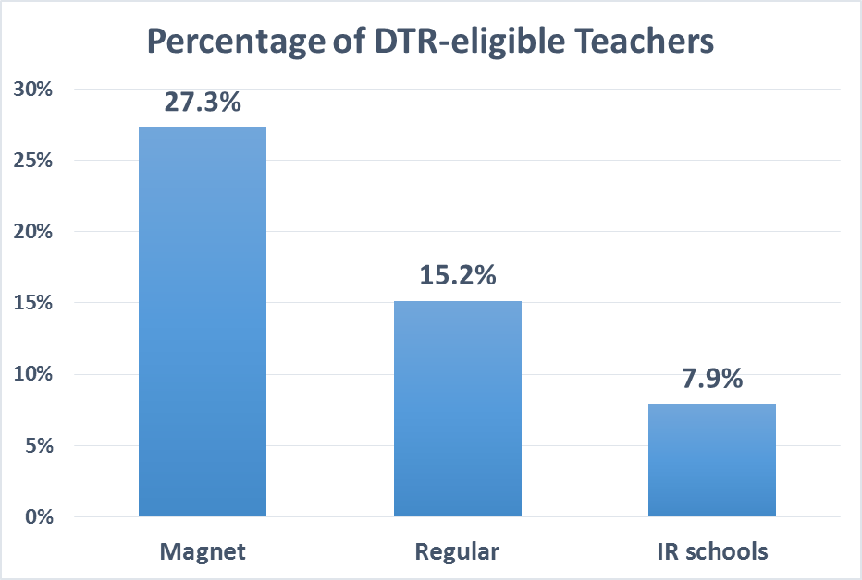
Principal and Teacher Effectiveness is Key in Turning Around Struggling Schools. Mirroring National Statistics, DISD’s Improvement Required Campuses in 2014 Reflected the Smallest Percentage of Distinguished Educators (“DTR”)
Magnet School Students 3.5x More Likely Than Students Attending IR Campus to Have a Distinguished Educator (Students Attending Met Std. Campuses Were 2x More Likely)
The students reflecting the MOST need were receiving the lowest percentage of well prepared/effective educators

Slide 25
Dallas ISD ACE Program Pilot of 7 Perpetually Improvement Required Schools
Determine most effective educators through multiple principal evaluations, student achievement growth and student survey
Provide financial incentives averaging $8k to $10k to better educators to relocate to most challenged schools
Longer school day with enrichment and after school tutoring, led by leader with high expectations
Measure data constantly and alter instruction accordingly

Slide 26
Dallas ISD ACE Program – Equitable Distribution of Effective Teachers
Average Double-Digit Gains for 13 of 14 Subjects Tested,
Substantially Outperforming Changes in State Performance
All ACE Students
% Gain in Passing STAAR (2015 vs. 2016)
State of Texas
% Gain in Passing STAAR (2015 vs. 2016)
Source: TEA STAAR Data

Slide 27
Dallas ISD ACE Program – Equitable Distribution of Effective Teachers
Even More Encouraging, 30%+ More Students in Early Grades Reading on Grade Level per ISIP Results Across All ACE Elementary Schools in Year 1 of ACE Program
+47%
+16%
+32%
+34%
+34%
+7%
+35%
+22%
+32%
+31%
+30.%
+11%
Source: Dallas ISD Evaluation and Assessment, 2015-2016 ISIP

Slide 28
Key Fundamental Levers for Change Two Fundamental Plays We Instead Try to Remediate Around
Every child shall arrive at Kindergarten prepared and ready for school
Every child shall be placed in front of an effective, well prepared educator

Slide 29
Detailed Recommendations
Full Day Funding to Increase Pre-K Enrollment
Increase EC Quality Thru EC-3rd Teacher Certification
Remove Rating Incentives to Place Better Teachers in Later Grades (Make 3rd Grade More Heavily Weighted)
Determine Better Educators, Then Incent Them to Relocate En Masse to Turnaround More Challenged Schools
Increase Rigor of Current Educator/Principal Preparation Pipelines and Increase Public Transparency of Results
Make a Career in Education More Aspirational

Slide 30
Appendix

Slide 31
Post Secondary Standard More Reflective of Achievement Than Passing Standard Proficiency % in the 60%-80% Range vs. 40%-50% at Current Passing Requirements
% of Questions Required to be Answered Correctly to Meet:
Less than 50% of Questions Answered Correctly
Source: TEA Spring 2015 STAAR Raw Score Conversions (Spring 2015 Paper Administration (English) – Grades 3-8 and EOCs)

