Slide 1
Learning List
™
1
Learning List
© 2015 Learning List
Notes:
Students can’t learn what they’re not taught.
I founded Learning List because, as an executive at the Texas school boards association, I heard repeatedly from superintendents who were tired of buying instructional materials that failed to teach students what the state standards required them to know and what they’d be tested on.

Slide 2
The Problem
Too Many Choices,
Too Little Time
> $500K in
unused IMs
Grade | Publishers’ Claimed Alignment % | Learning List’s Alignment %
5 | 100% | 100%
6 | 100% | 66%
7 | 100% | 50%
8 | 100% | 75%
2
Learning List
© 2015 Learning List
Notes:
Reviewing instructional materials is complicated, particularly in this rapidly evolving marketplace where there are more products and they are more complex than ever before.
Districts don’t have the time or staff to thoroughly review materials before they buy them.
The state’s adoption process helps, but there are usually too many state-adopted products in a grade and subject for districts to review each thoroughly per grade and subject for
So they often so, they often resort to relying on the publisher’s claims.
On average, districts have more than $500K in unused instructional materials (IMs) because the products they purchased didn’t live up to the publisher’s claims.
Our data corroborates their experience. Only about half (54%) of the materials that claim to be aligned to the 100% of the standards, actually are.
As a result, districts are wasting millions of dollars and students are being shortchanged.

Slide 3
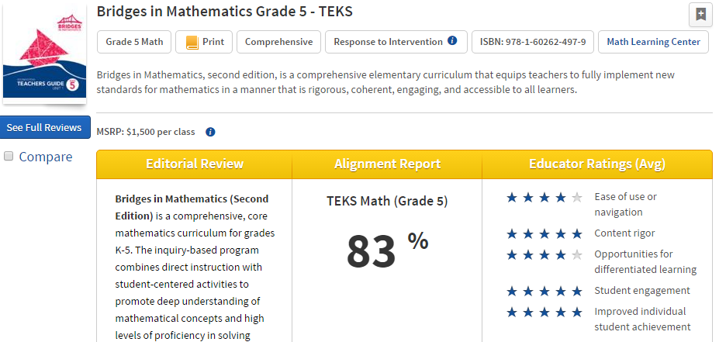
Learning List’s Reviews
1
2
3
4
Better Information Better Choices Better Results
3
Learning List
© 2015 Learning List
Notes:
Learning List solves both problems.
Like Consumer Reports®, Learning List is a subscription-based service that provides independent reviews of instructional materials, including a review of the material’s alignment to the TEKS and/or AP course frameworks.
Provide 3 types of professional reviews of preK-12 instructional materials
Spec Sheet
Alignment Report
Editorial Review
Review instructional materials (online, print, DVDs), test prep and test banks
Have reviewed over 1,000 IMs for the four core subjects and tech apps, and AP courses
Our reviews help administrators to choose and teachers to use their instructional materials more effectively.

Slide 4
How Learning List Complements the State Adoption Process
Use TEA’s Breakout to review alignment of non-state-adopted materials
Provides additional types of reviews to meet districts’ needs:
For state-adopted materials, features state alignment report + spec sheet + editorial review + subscriber ratings & reviews
For non-adopted: develop independent alignment report + spec sheet + editorial review + subscriber ratings/reviews
Notes:
Alignment reports are downloadable
Side by side comparison of the alignment of multiple products in a grade/subject

Slide 5
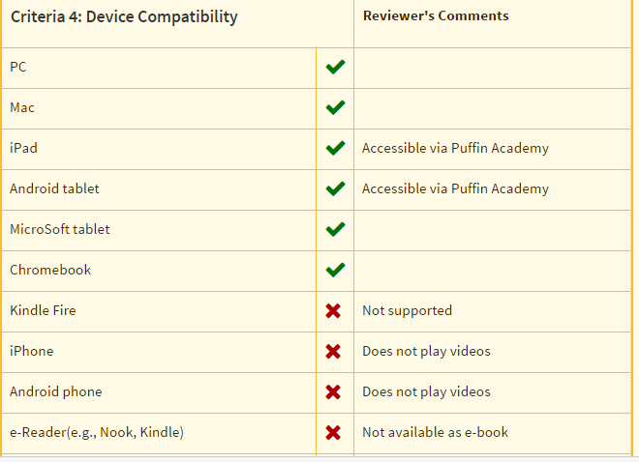
Learning List Spec Sheet

Slide 6
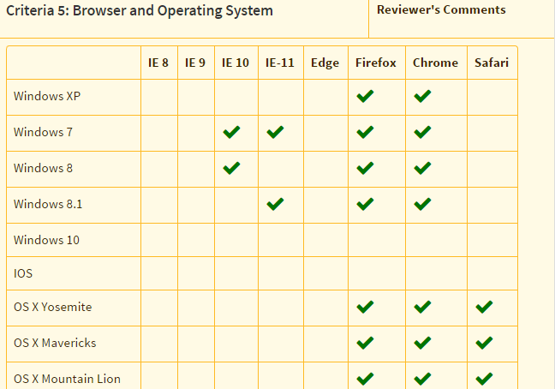
Learning List Criteria 5

Slide 7
How Learning List Complements the State Adoption Process (cont.)
Additional types of materials reviewed:
State-adopted, non-adopted, free Open Educational Resources
Comprehensive
Supplemental (RtI, Credit Recovery, ELL/LEP, GT, Spec. Ed)
Test prep, test banks
Advanced Placement
A service – what’s reviewed is driven by subscriber requests
Organic review process
Publishers can submit new content every 6 months
Tools make the information actionable
Instructional resource, not just for selection

Slide 8
Trends: Prices Vary … A Lot
Comprehensive, 100% aligned Economics materials vary in price by up to $81 per student over 8 years.
Product | State-Adopted? | Alignment % | Price | Annual Price per student
#1 | Yes | 100% | $114.97 per student (print and 8 yr. online) | $14.37
#2 | Yes | 100% | $89.94 per student (print and 8 yr. online) | $11.24
#3 | Yes | 100% | $33.95 per student (print only) | $4.24

Slide 9
No “Relationship” between Price and Alignment %
Comprehensive, 100% aligned Algebra I products vary in price significantly over the adoption.
Product | State-Adopted? | Alignment % | Price over Adoption Period | Annual price per student
#1 | Yes | 100% | $95.90 per student (print and 8 yr. online) | $11.99
#2 | Yes | 100% | $98.65 per student (8 yr. online and consumable ) | $11.08
#3 | No | 100% | $55.00 per student (6 yr. online with live teacher) | $9.17

Slide 10
State-adopted vs Non-adopted
State-adopted vs Non-adopted
Grade 5 Math | State –Adopted? | Alignment % | Annual per student Price
Product 1 | Yes | 100% | $10.46 per student if 25 students per class
Product 2 | Yes | 100% | $9.40 per student
Product 3 | Yes | 100% | $6.72 student if 25 students per class
Product 4 | No | 100% | $6.60 per student if 75 students
Product 5 | No | 98% | $.87 per student if 75 students
Product 6 | No | 93% | $12.95 per student

Slide 11
Market Trends
Increasing number of digital products (without print component)
Increasing number of supplemental products produced by boutique publishers => greater choice for districts
Districts purchasing more supplemental materials
Districts are contracting for 2-3 years at a time
Districts seeking online adaptive materials (instruction and feedback) to help teachers differentiate instruction
Biggest complaints from districts:
(1) onboarding/refreshing;
(2) single sign-on
Educators starting to focus more attention on “alignment” as indicator of quality

Slide 12
Marketplace Impact
Providing greater transparency to make the marketplace work more efficiently;
Reviewed over 1,000 materials by more than 100 publishers; publish ~50 reviews each month (over 130 materials submitted this month)
Democratizing information among districts; expanding districts’ choices;
Amplifying districts’ collective voice; empowering informed choice;
Helping districts save money (by making comparison shopping easier)
Helping districts save time (in selection and instruction)
Helping educators use their materials more effectively;
Helping publishers improve alignment of materials/enhance features;
Expanding publishers’ marketing reach (esp. to smaller districts);
Helping publishers more easily do market research and identify market holes/new niches

