Slide 1
The Science of Learning – Serving the Art of Teaching
The Science of Learning Serving the Art of Teaching
Richard Keaveny| Vice President| McGraw-Hill Education November 2015

Slide 2
Education is Changing
Education is changing

Slide 3
Changing and Purposeful Activity
Education is changing
Education is a purposeful Activity

Slide 4
Changing and Purposeful Activity and Unlocking
Education is changing
Education is a purposeful Activity
Education is unlocking the full potential of each learner

Slide 5
Learning is driven by great teachers
Learning is driven by great teachers

Slide 6
Art of Teaching
Science of Learning
Adaptive Engines and Personalized Learning Tools

Slide 7
Thousands of Products, Millions of users, Billions of Small Data Points
thousands of products
millions of users
billions of “Small data” points

Slide 8
Subject matter experts, Learning and data scientists, Engineers
Subject matter experts
learning and data Scientists
engineers

Slide 9
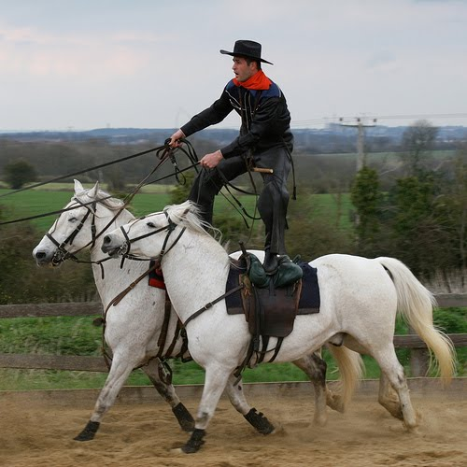
Picture of Man on Horses

Slide 10
Engaging, Easy-to-Use, Efficient, Effective
Engaging
Easy-To-Use
Efficient
Effective

Slide 11
Learning Moment
We Are part of a solution not the entire solution
We are Part of an Open system, based on open standards, and interoperability
We support IMS Global (Caliper, LTI, QTI) and other open standards bodies

Slide 12
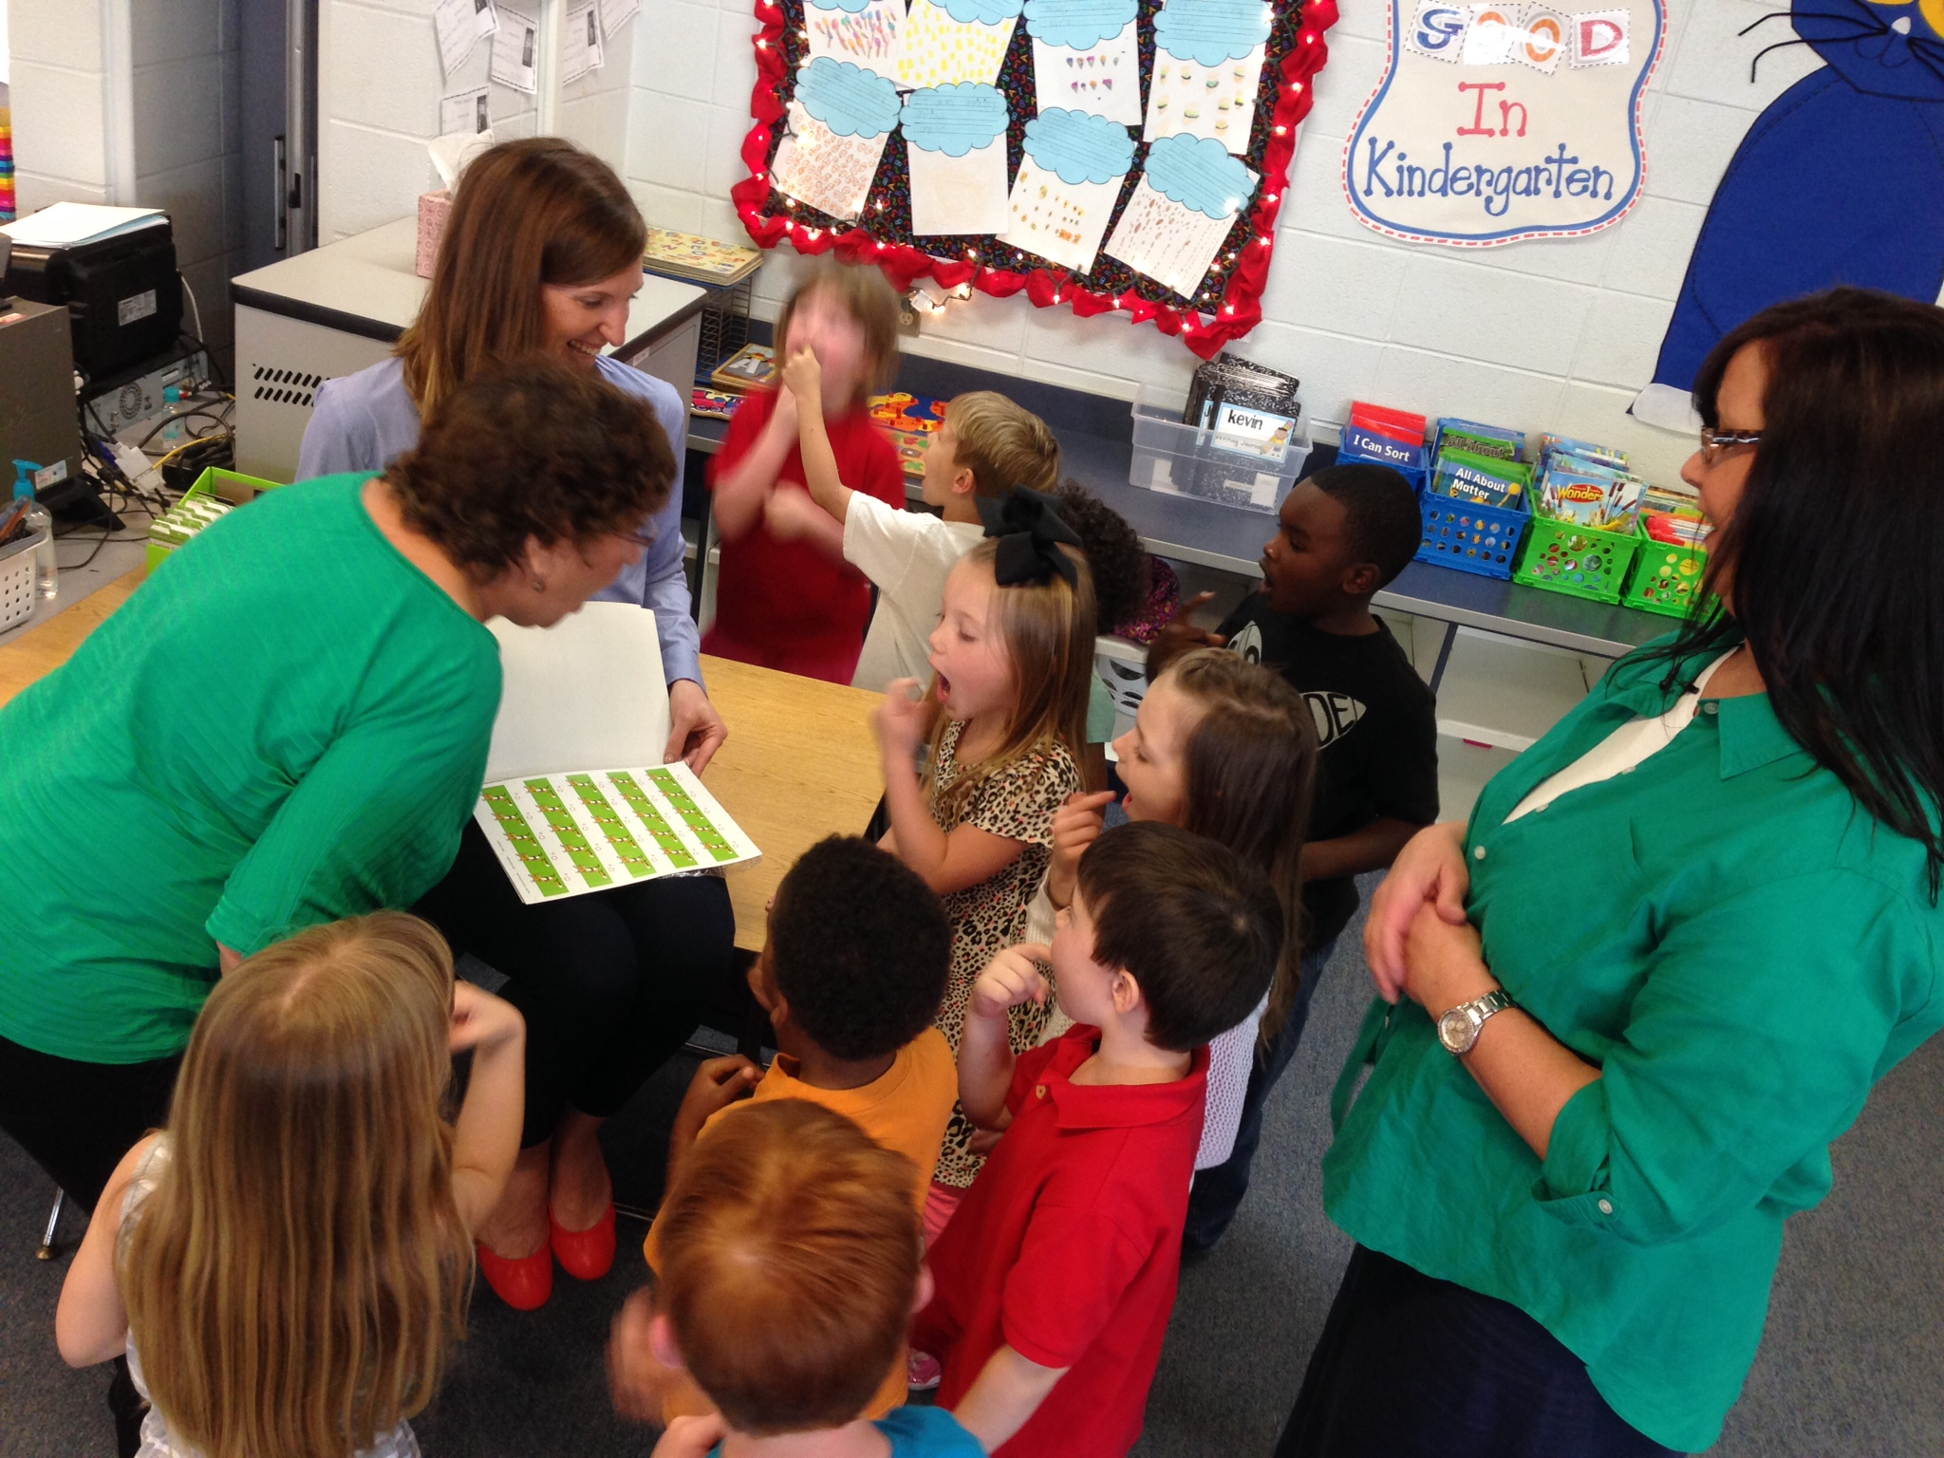
Bloom’s Two Sigma Problem
Student achievement improves dramatically for students who receive
one-on-one instruction

Slide 13
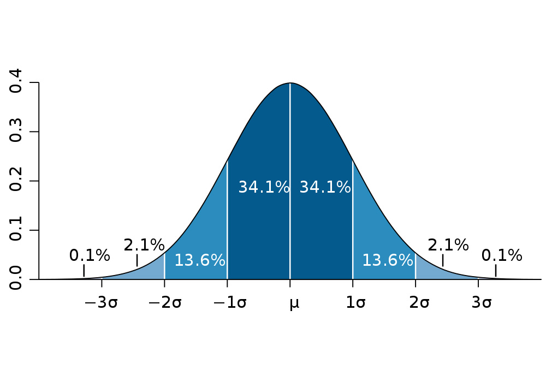
Normal Distribution
Normal Distribution

Slide 14
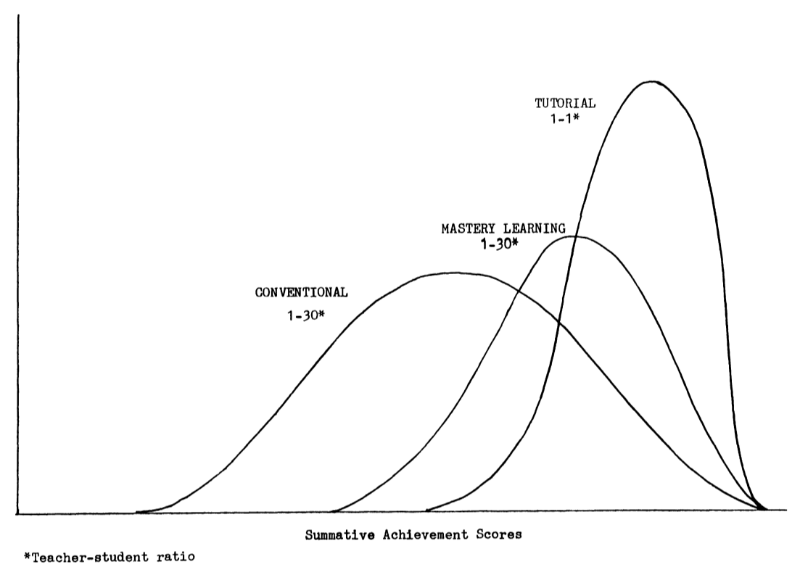
Summative Achievement Scores
from "The 2 Sigma Problem: The Search for Methods of Group Instruction as Effective as One-to-One Tutoring"

Slide 15
Education is Local

Slide 16
Thank you
Learn more at McGraw-Hill Education
I would love to hear from you richard.keaveny@mheducation.com

