Slide 1
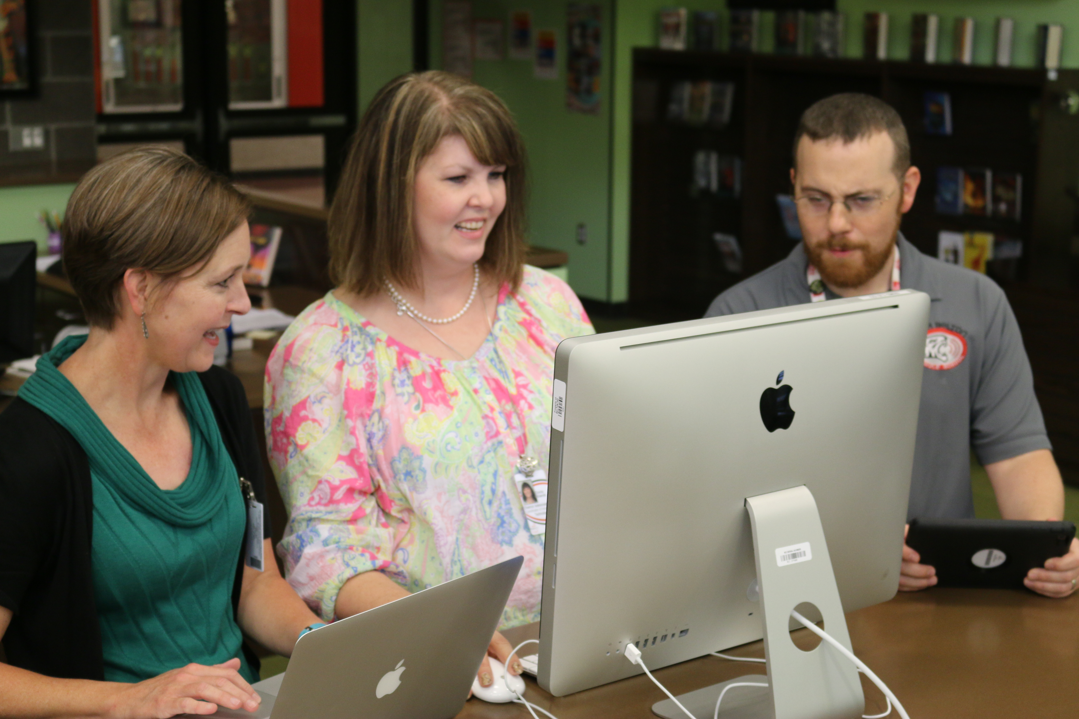
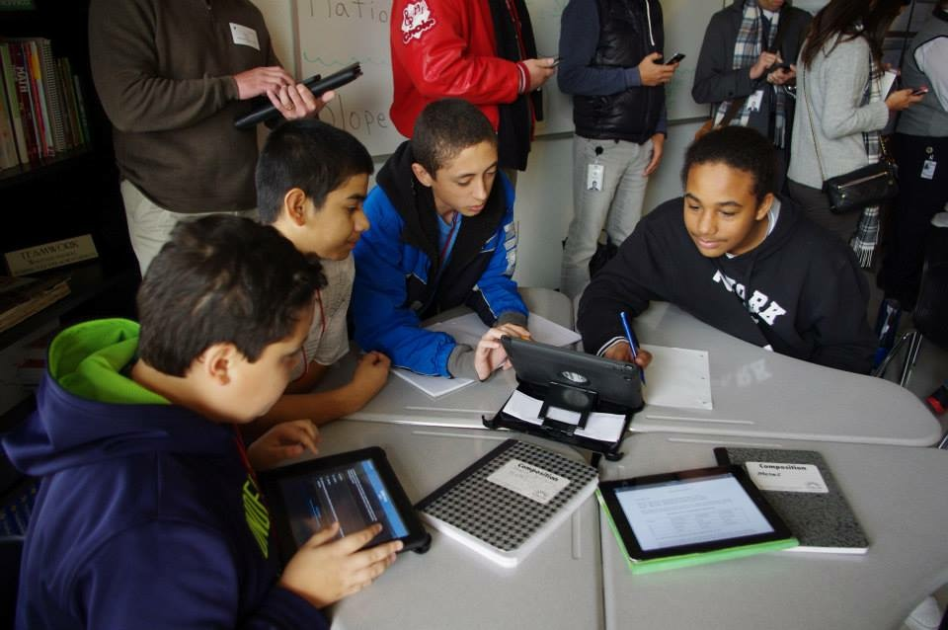
Digital Learning
in
Belton ISD

Slide 2
A Fast-Growth District
198.6 square miles
10,540 students
55.2% White
32.1 % Hispanic
6.4 % African American
45.6% Eligible or Reduced Priced Meals
10.9% Special Education
8.9% Gifted and Talented
8.0 % Military Connected
7.0 % Limited English Proficient
15 schools include 1 early childhood, 9 elementary, 3 middle and 2 high schools
A Fast-Growth
District

Slide 3
Secondary Student Devices 2011 - current

Slide 4
Elementary Student Devices
There is a 1:3 ratio of devices to students at all K - 5 elementary campuses.
In 2014, Southwest received the
Technology Lending Grant to provide
1:1 ipads in 3rd - 5th grades.
PTA and BEEF grants have provided
iPads in K-5 and
1:1 Chromebook initiatives in
5th grade.

Slide 5
What do you think Texas should be doing over the next five years regarding the transition toward digital that will ensure all teachers and students have the best environment for learning and are successful?

Slide 6
The vision of Belton ISD is to be a leader in preparing every student to excel in tomorrow’s world.
Visionary
Planning
Organization
Economic
Management
Motivation

Slide 7
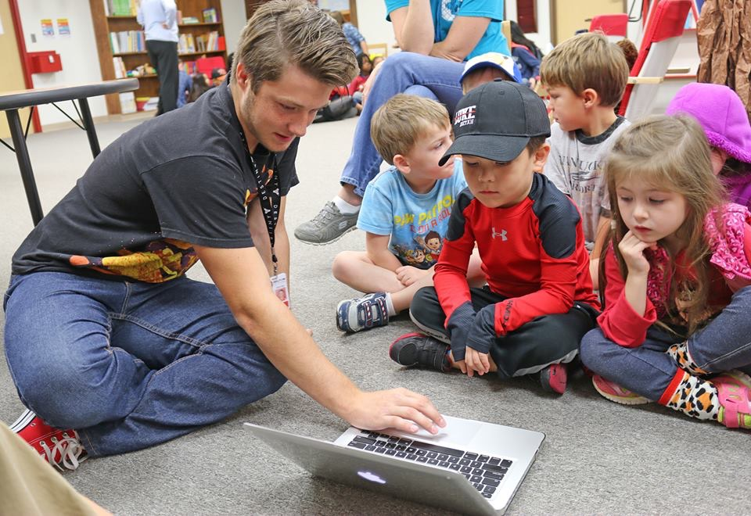
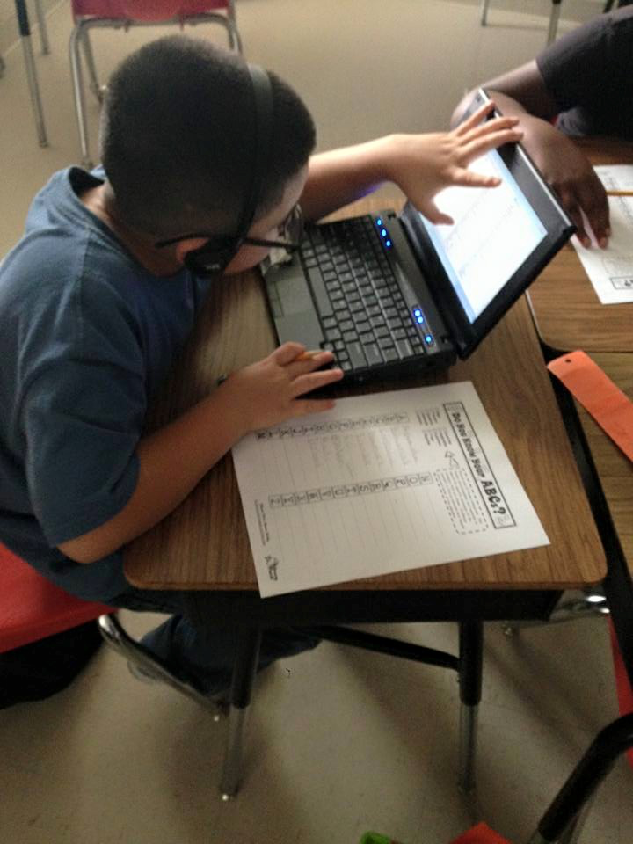
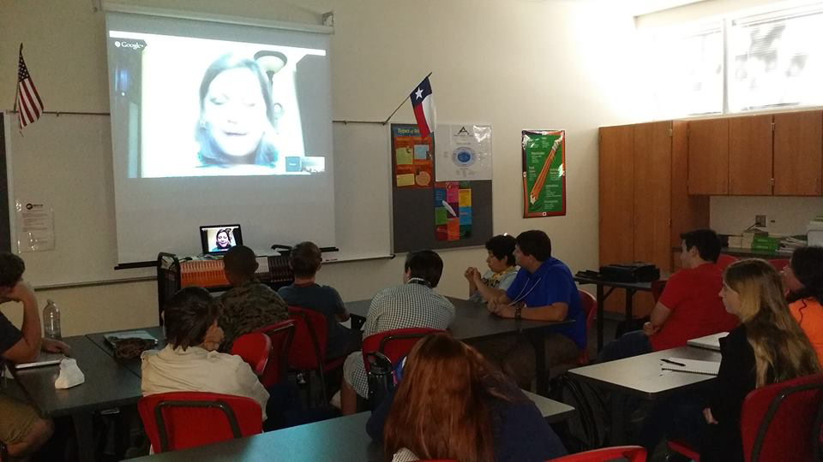
Teaching & Learning
Communication
Critical Thinking
Collaboration
Creativity

Slide 8
Curriculum Development
Begin with the TEKS.
Able to use TEKS, digital content and teacher expertise to design curriculum.
Curriculum reviewed quarterly and revised annually.

Slide 9
icons
icon

Slide 10
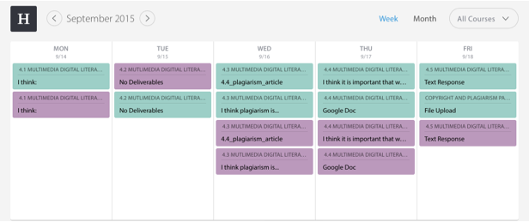
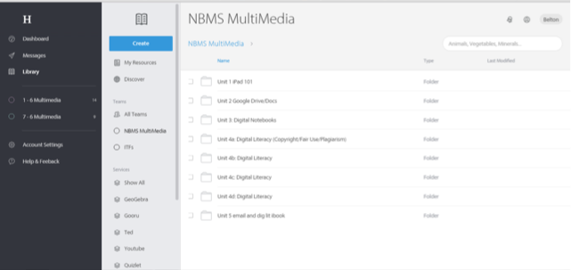
Learning Management System (Homeroom and Echo)

Slide 11
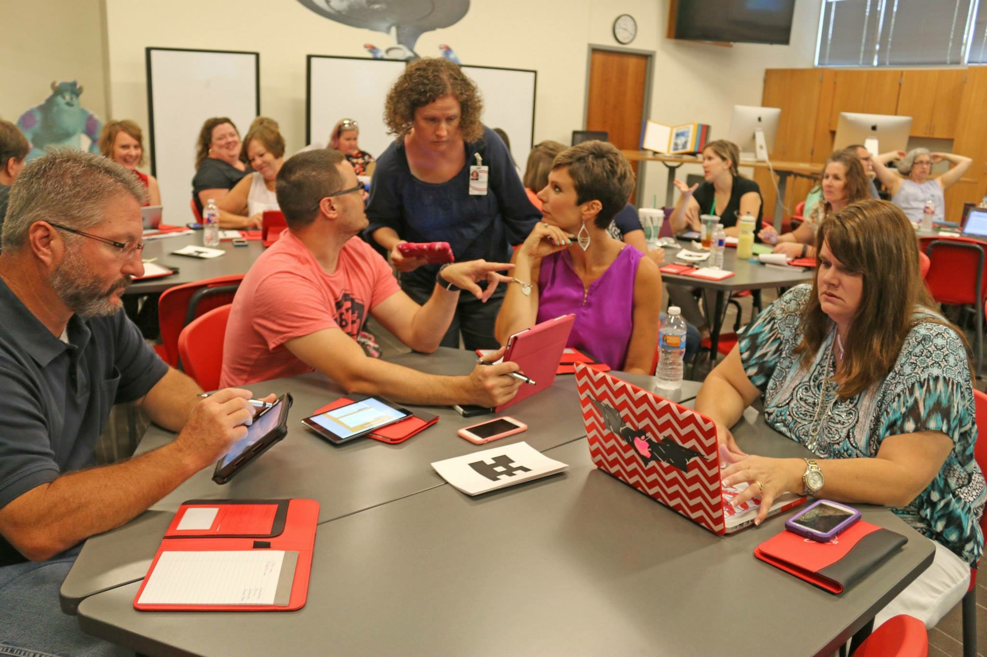
On-going Professional Development

Slide 12
Compelling Evidence of Success

Slide 13
BrightBytes

Slide 14
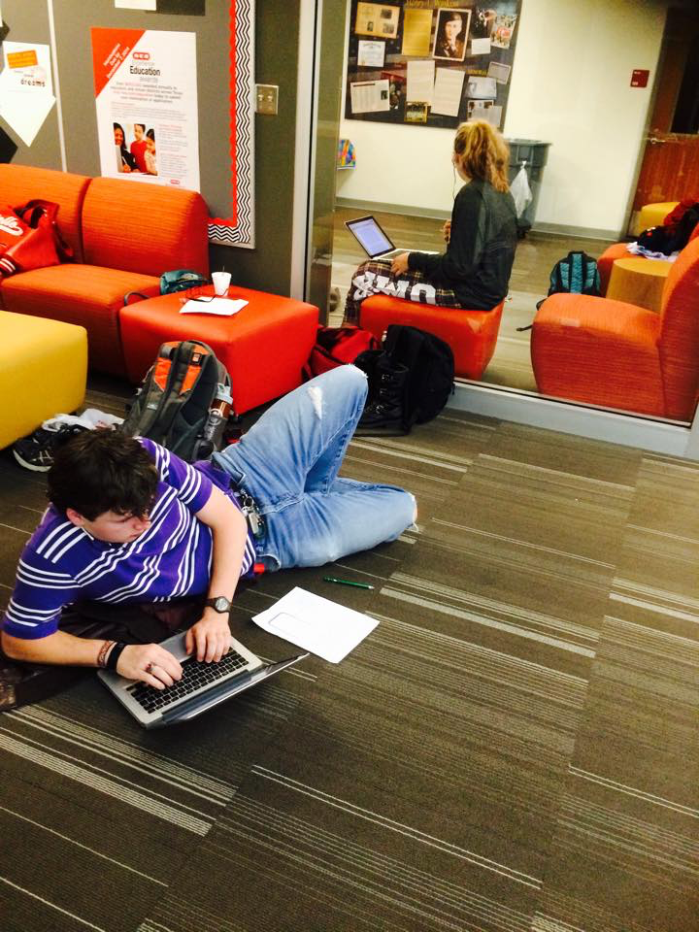
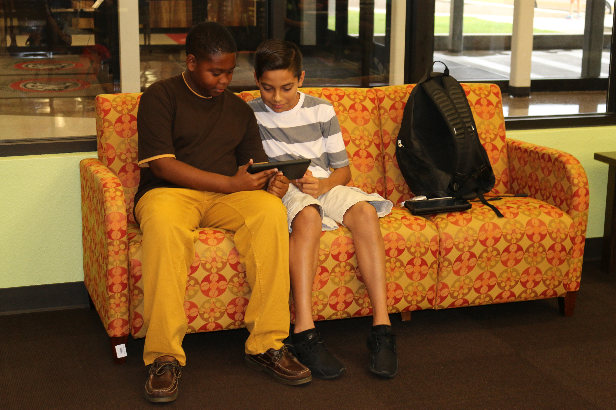
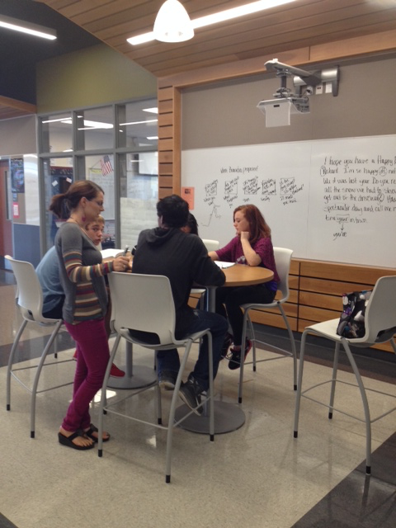
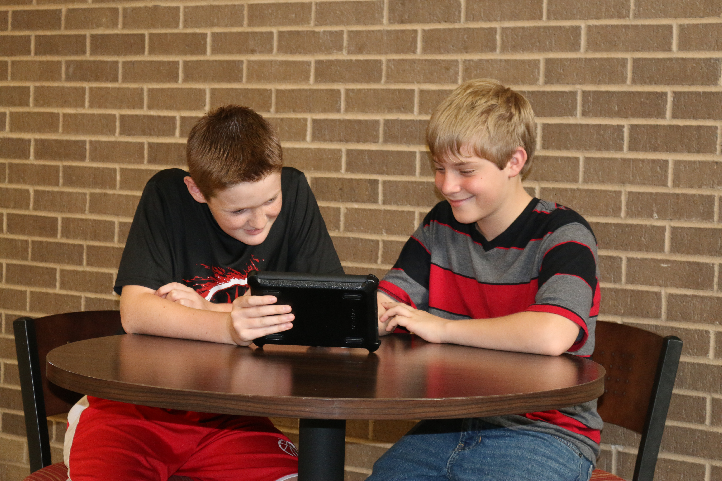
Flexible Learning Environment

Slide 15
Next Level Work
Technology Visioning Committee
District Technology Replacement Plan
Next Steps for Elementary
Continued involvement in current Digital Learning opportunities: Google and Apple Education Seminars
Course Development in iTunes U
Continuation of focus on 4 C’s
Continued Instruction in Digital Citizenship
Continued professional development for teachers

