Slide 1
Instructional Materials Matter: Educating the Digital Generation
Northwest ISD
Karen G. Rue, Ed.D.
Superintendent of Schools

Slide 2
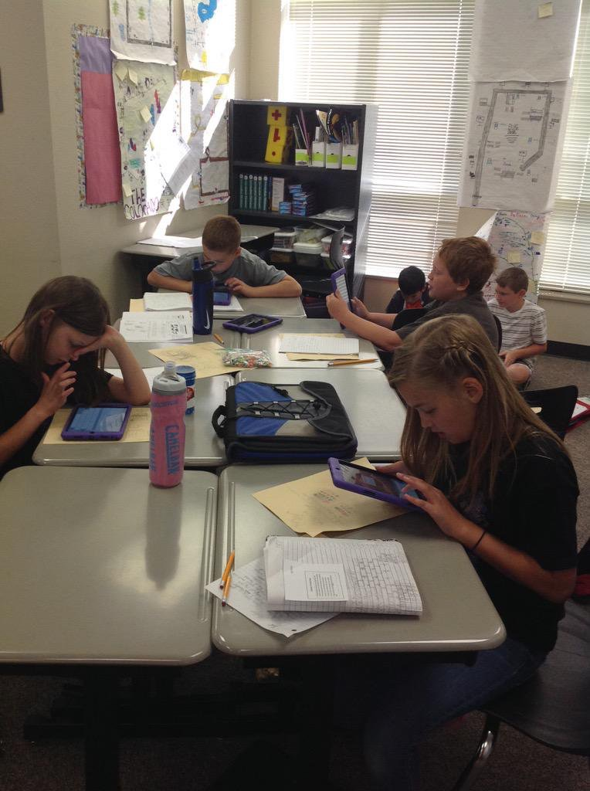
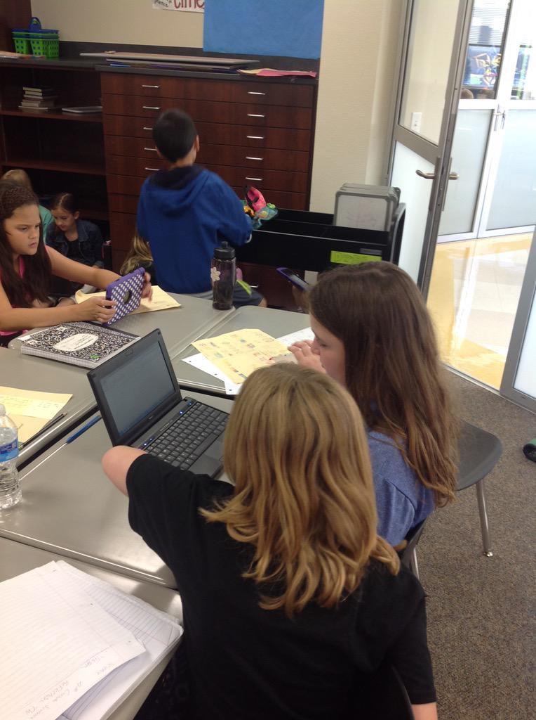
Value of the Resources
Notes:
Imagine being a learner and having every resource and connection at your fingertips. In the digital generation this can be a reality for all of our learners. Our educators and leaders understand that leveraging digital materials, both in the classroom and at home, provide the opportunity for students to become progressively active learners, problem-solvers, and creative thinkers. We need your help, as the State Board of Education, to adopt a set of standards that will make this a reality.

Slide 3
What do students need for their future?

Slide 4
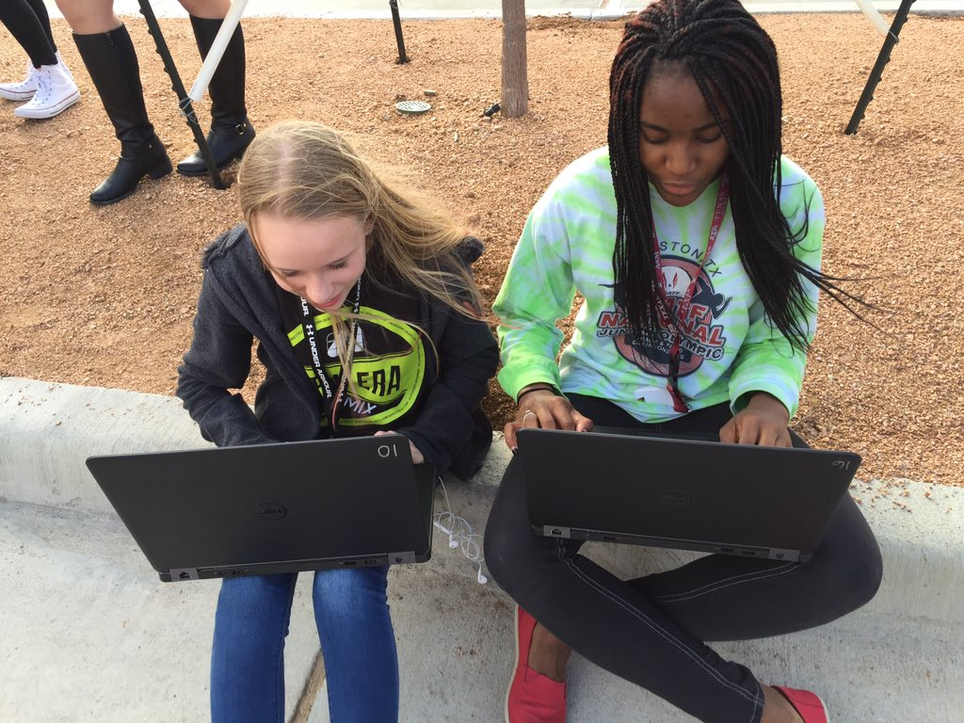
What Do Kids Request?
Ubiquitous, anywhere, anytime access
Interactive, personalized, adaptive
Elevated control of content
More dynamic than a PDF
Ability to manipulate and annotate
Ease when logging in

Slide 5
Defining Cross-Platform Support
Materials should be accessible on any device
Students require consistent access to materials
Login requirements must be standard
Access methods must be standard
Integration must be standard
Notes:
Students deserve access to their digital textbooks on any device. Most textbooks/digital materials are web based and accessed through a URL. Students should be able to access that web based content whether they are on a iPad at school, laptop at Dad’s house, or a phone in the car.
Login requirements must be standard. (This means that each student will log in the same way every time.) Some companies require a student to log in with one set of credentials and their second class is another set of credentials. The result is that the student has to remember multiple usernames and passwords depending on the class they are in.
Access methods must be standard-Students should be able to access their content/textbook from any browser or device. If the SBOE requires all companies to create content in HTML5 or higher, students would have better access on any device. Currently, they are spending a significant amount of time making sure everything is installed (versions of java, flash) so that they can access their textbooks. Our students should not have to check for browser plug ins EVER in order to access their textbook.
In addition, the SBOE could adopt a standard that textbooks/materials are accessible through the web. Students should not have to download a program on a device in order to access their content/textbooks.
Integration must be standard. This refers to the way students’ data is applied to the individual textbooks and allows student access to the content via logging in. Example: Right now, some digital textbooks require the teacher to batch upload students every time a new student enrolls. Some digital textbooks allow students to enroll themselves and create their own log in information. Some digital textbooks talk to our learning management system and allow students to access the materials directly from Moodle. Some integrate with our Google (Google Apps for Education) log ins and it allows our students to use their Google credentials to access their textbooks.
Solution: The SBOE could adopt a set of standards that require every textbook vendor to set up their integration in a way that accepts student data via the directory each school district currently utilizes. Whether the district uses LDAP (NISD utilizes this), eDirectory, Active Directory, and the list goes on.
Solution: The SBOE needs to define a set of standards with how student data looks. All textbook vendors and school districts need to use the same information. Example: When we integrate student birthdays into their system, we have mm/dd/yy. In Pearson textbooks, they need the birthday in a different format. By utilizing the one format for data, it would save a significant amount of time.
An example of a suggested standard for data: Name - Some publishers allow 20 characters for first name, 24 characters for last name, birthdays are month/date/year with leading zeros, state ids need to be 12 characters, etc. Districts should not define standards about the way they set up data, rather the SBOE should define the way data should look.
Side note:
LDAP- Lightweight Directory Access Protocol-It’s a directory (or list) that allows you to quickly look up information the directory references.

Slide 6
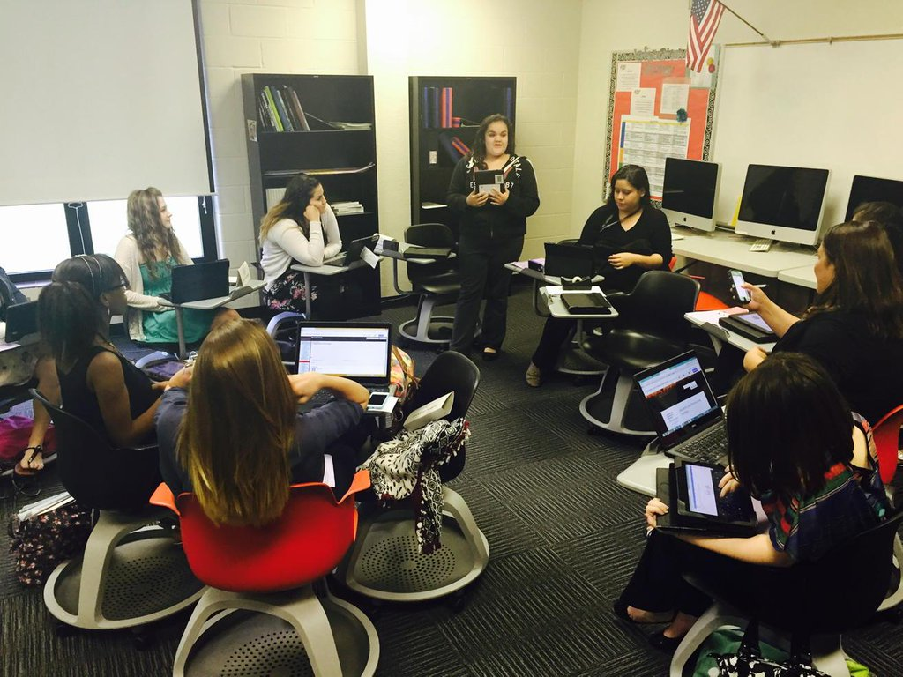
Current Issues
Cost of materials
Unsustainable models, need additional allowance for growth in materials procurements (90-110% of purchase)
Unclear requirements for access methods
Some vendors’ models of access are so convoluted it takes a data expert in the technology department to link the student system to the requirements of the instructional material

Slide 7
Current Issues
Lack of standards for student data security
Who has access and how is the data secured?
Current adoption cycle is not realistic for digital materials
Cost of current adoption may not include upgrades

Slide 8
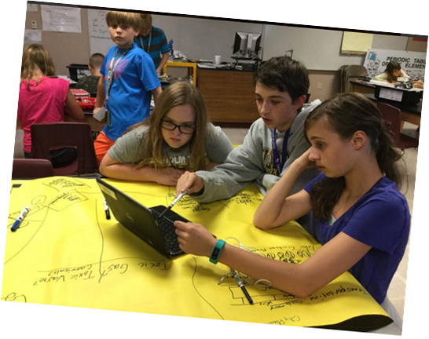
Recommendations
Define technical specification standards for instructional materials
Define standards for student privacy
Define standards for data integration
HTML5
Set format for student data
Provide seamless access for staff and students
Notes:
We recommend that the SBOE adopt a set of standards or rules regarding:
-access on any device
-logins
-privacy
Those standards do not need to be decided today, but the SBOE can make the commitment to move forward with establishing a set of standards. For technical recommendations, we recommend that the SBOE could build a committee of CTO and technology executives to decide to details.
Textbooks and instructional materials should be HTML5 compliant and not use java or flash.
When textbooks access student information, we need to know that their information is being kept private. Possible repercussions are that student data may be at accessed by a third party with no educational interest.
In addition, all vendors should have a log of who accesses data and that log should be kept for a minimum of 90 days. Possible repercussions are that student data may be at accessed by a third party with no educational interest. The SBOE needs to set a standard because our student’s privacy is a top priority to districts and needs to be a priority for textbook vendors as well.

Slide 9
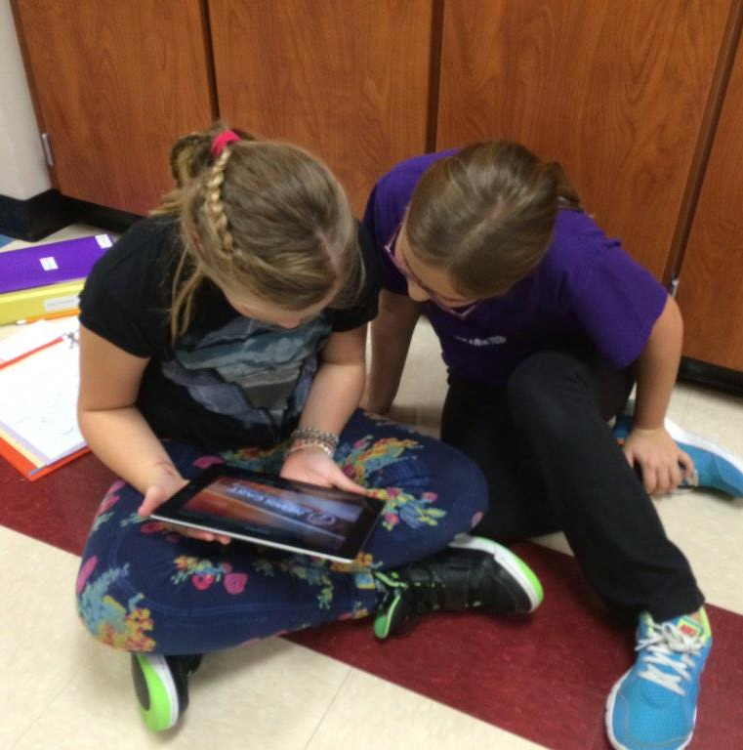
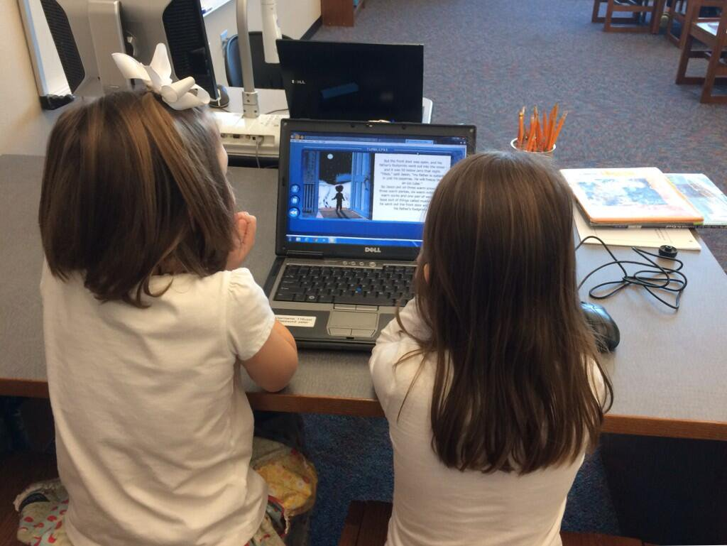
Page of photos
Notes:
This is the world our kids want. We need the SBOE’s help in making this learning environment a reality.

